Slide 1
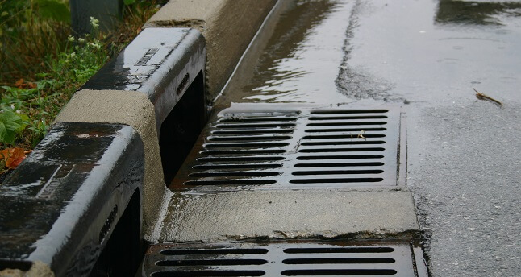
Drainage Plan
Prepared By:
Gabriel Garcia
Elizabeth Samura
Andres De La Cruz

Slide 2
Overview
Drainage Background
Purpose
Drainage Plan
Purpose
Flow Rate
Type of drainage system
Plan & Quantity

Slide 3
Drainage Background & Purpose
Drainage: Natural or artificial removal of surface or subsurface water from a given area.
Purpose: To provide a safe passage for vehicles during the design storm event by :
COLLECT surface runoff rapidly
CONVEY the runoff efficiently
DISCHARGE the runoff safely

Slide 4
Drainage Plan
Purpose: Drainage plan provide a visual representation in plan view aspect of the drainage facilities. Drainage profiles must contain the data necessary to install and construct new drainage facilities.

Slide 5
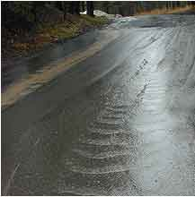
Flow type
Sheet Flow: is flow of uniform depth over plane surfaces and usually occurs for some distance after rain falls on the ground.
Channel flow: Defined as fluid flow with a free surface open to the atmosphere or pipes that are not full.
Culvert or Storm Drain Flow

Slide 6
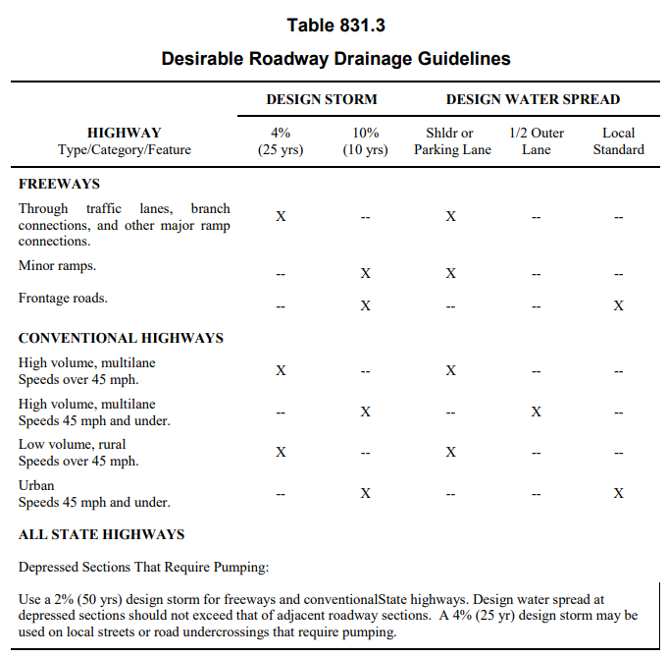
Flow Rate, Q
Rational Method Equation: Q = c.i.A
Q = Peak discharge, cfs
c = Runoff coefficient
i = Rainfall intensity, in/hour
A = Drainage area, acres

Slide 7
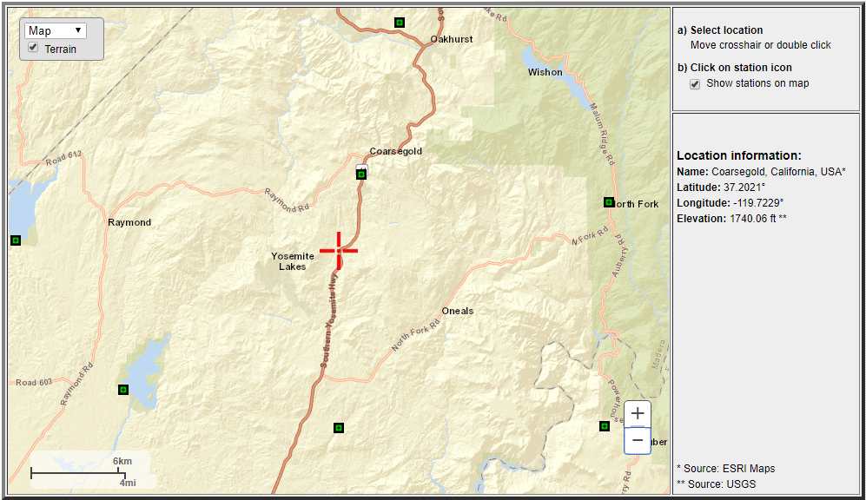
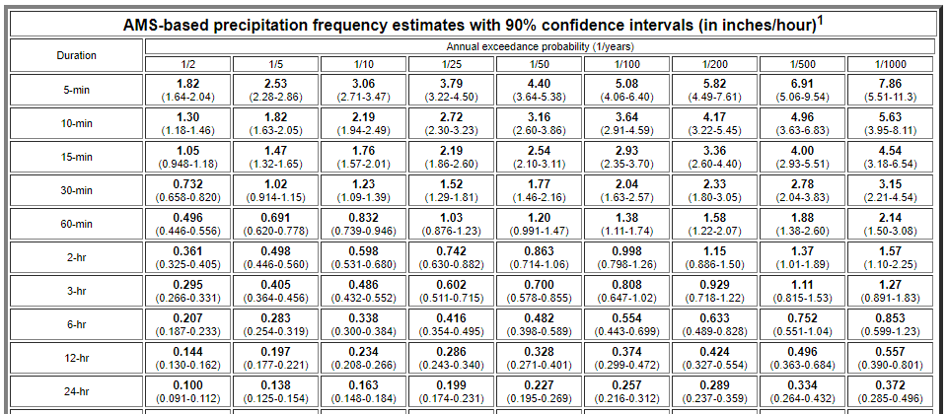
Flow Rate, Q
https://hdsc.nws.noaa.gov/
Tc = 10 min
i = 2.72 in/hr

Slide 8
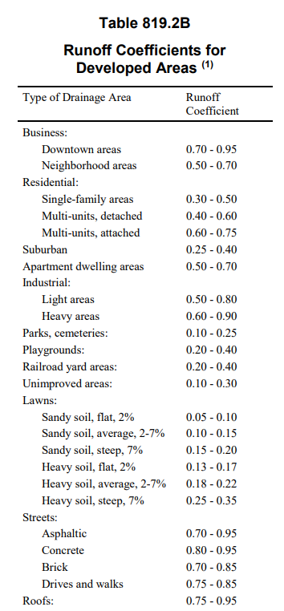
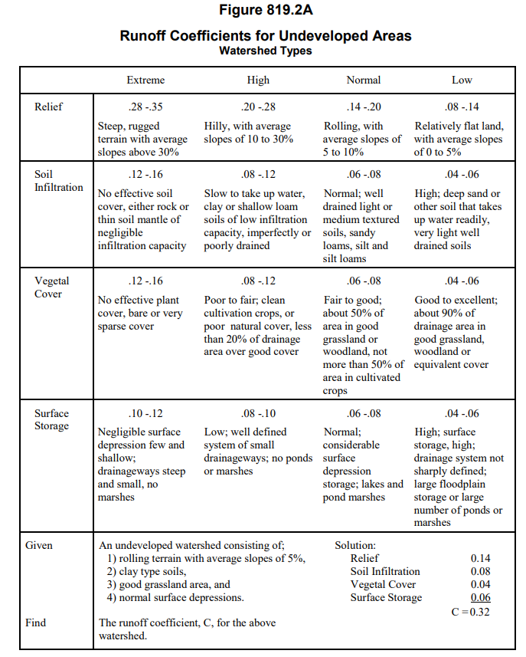
Flow Rate, Q
Runoff Coefficient, c
Asphalt: c = 0.70 - 0.95
c = 0.95

Slide 9
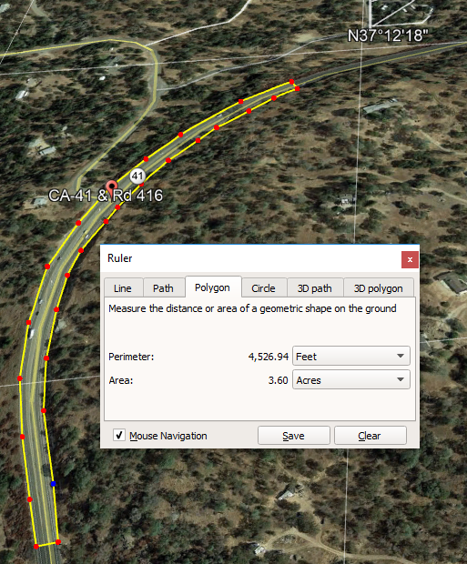
Flow Rate, Q
A = 3.60 ac
Qpeak, 25 yr = ciA = (0.95)(2.72)(3.60) = 9.30 cfs
Our value Q = 10.0 cfs

Slide 10
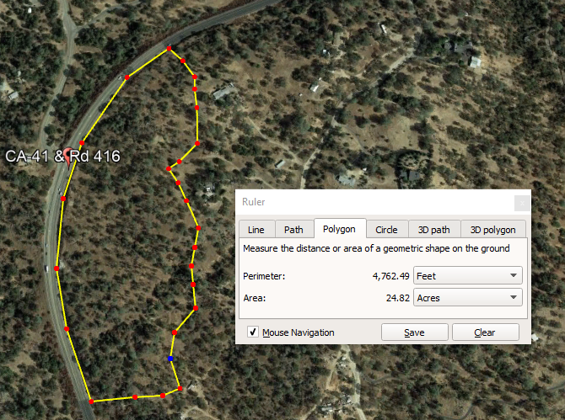
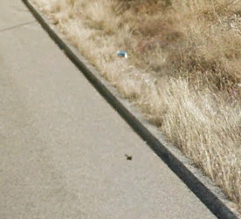
Outside Flow
A =24.82 ac
c = 0.32
Q, 25 yr = ciA = (0.32)(2.72)(24.82) = 21.6 cfs
Final Q = 21.6 + 9.30
= 30.90 cfs

Slide 11
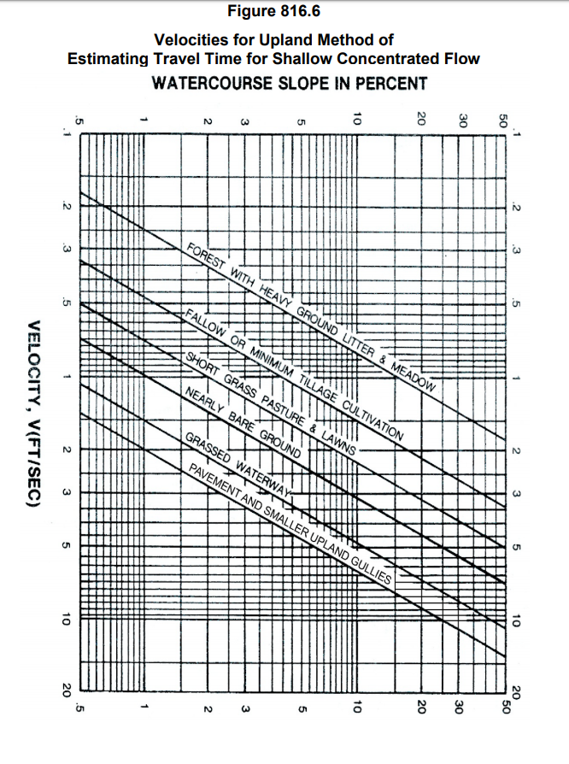
Water velocity
Slope =7%
V = 5.25 ft/sec

Slide 12
Drainage system
The following data is to be given for the units of each drainage system:
Type, size, length, and location of culverts (station pluses and station offset distance)
Culvert appurtenances, such as drainage inlets and outlet structures are shown and labeled.
Identify location of items by plus station and station offset distance.

Slide 13
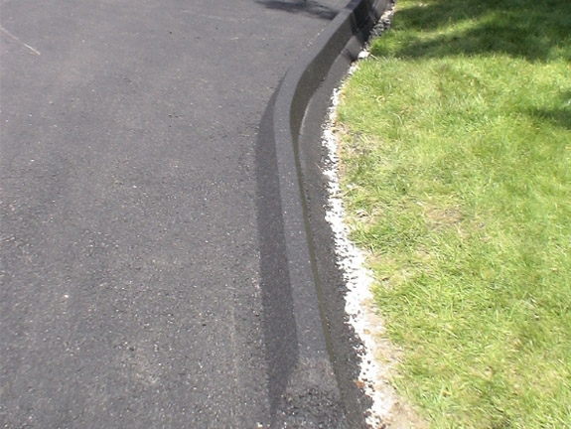
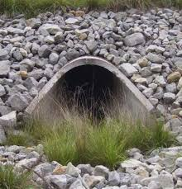
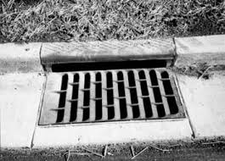
Drainage system
The Drainage inlet system consist of the following and are spaced appropriately to reduce water spread.
Dike - triangular gutter
Curb and Grate combination storm inlet.
Storm drain pipe
Culvert: Pipe & Flared End

Slide 14
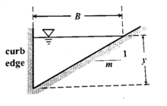
Dike
Dikes placed adjoining the shoulder provide a paved triangular gutter within the shoulder area; are to be used only as necessary to confine drainage and protect side slopes susceptible to erosion. For a triangular gutter section, the minimum length of shoulder can be calculated as follows: Q = VA (Flow Rate equation) A = 1.90ft^2 Depth of curb (y) = 6in = 0.5ft Area of Triangle = By/2 B = Min Length of Shoulder Bmin= (1.90*2)/0.5 = 7.6ft

Slide 15
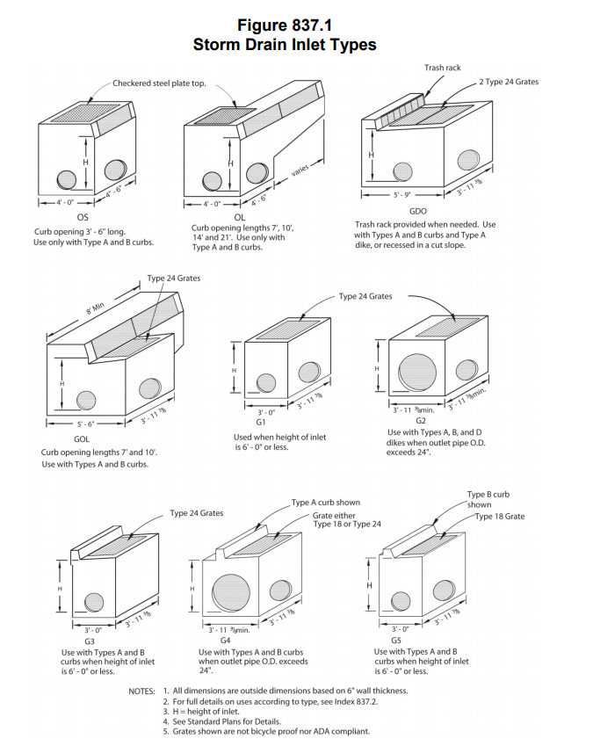
Curb and Grate combination storm inlet
Combination inlets provide both a curb opening and a grate. These are high capacity inlets.Type GDO have a curb opening directly opposite the grate. The GDO inlet has two grates placed side by side and is designed for intercepting a wide flow. A typical use of these inlets would be in a curb and gutter installation or within a shoulder fringed by a dike.

Slide 16
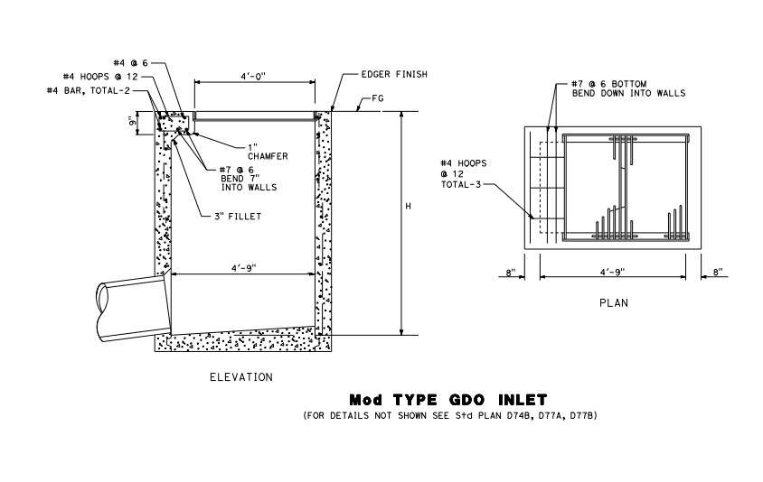

Slide 17
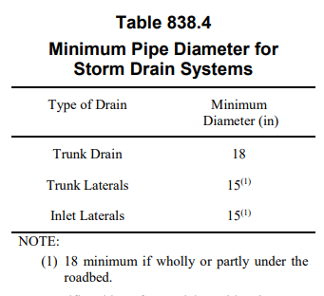
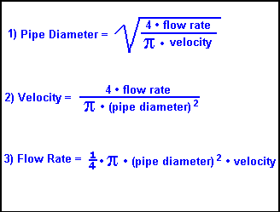
Subterranean storm pipe
Pipe Diameter. The minimum pipe diameter to be used is given in Table 838.4.
Based on Q and V, D = 18.6 in
Next nominal size is 20 inches

Slide 18
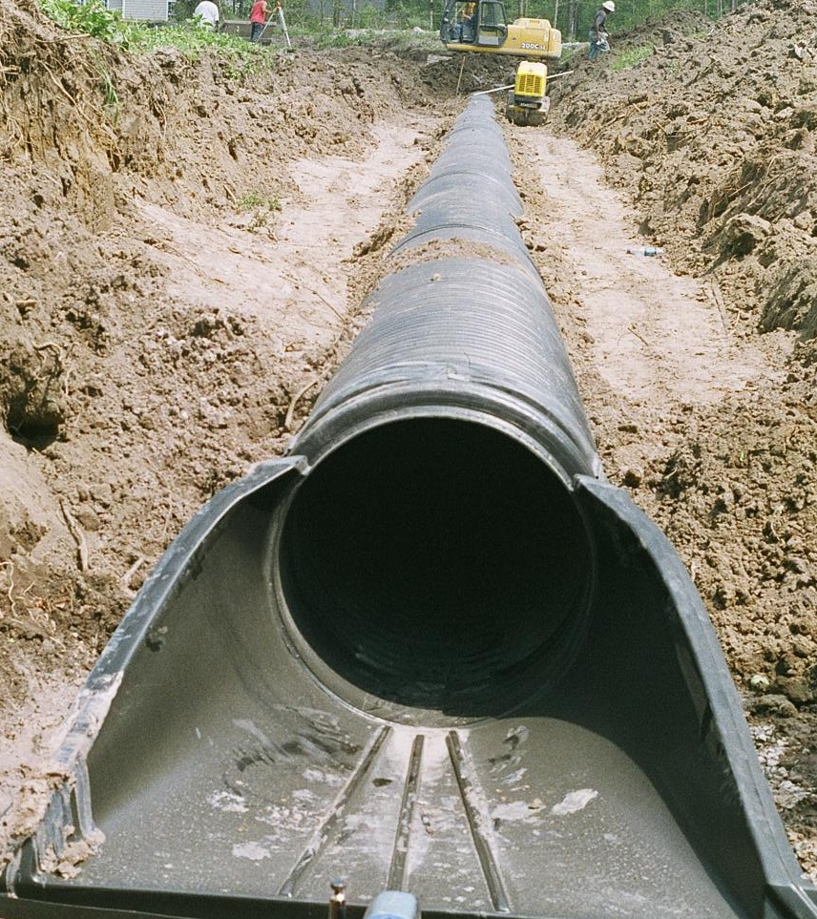
Culvert
The highway culvert is a special type of hydraulic structure. Most culverts operate under inlet control.
(Q/AD^0.5) ≥ 4; D = 19.07 in
Material: Precast reinforced concrete, n = 0.012
Diameter: 24 in
Length : 100 ft
End Treatment: Flared End Sections

Slide 19
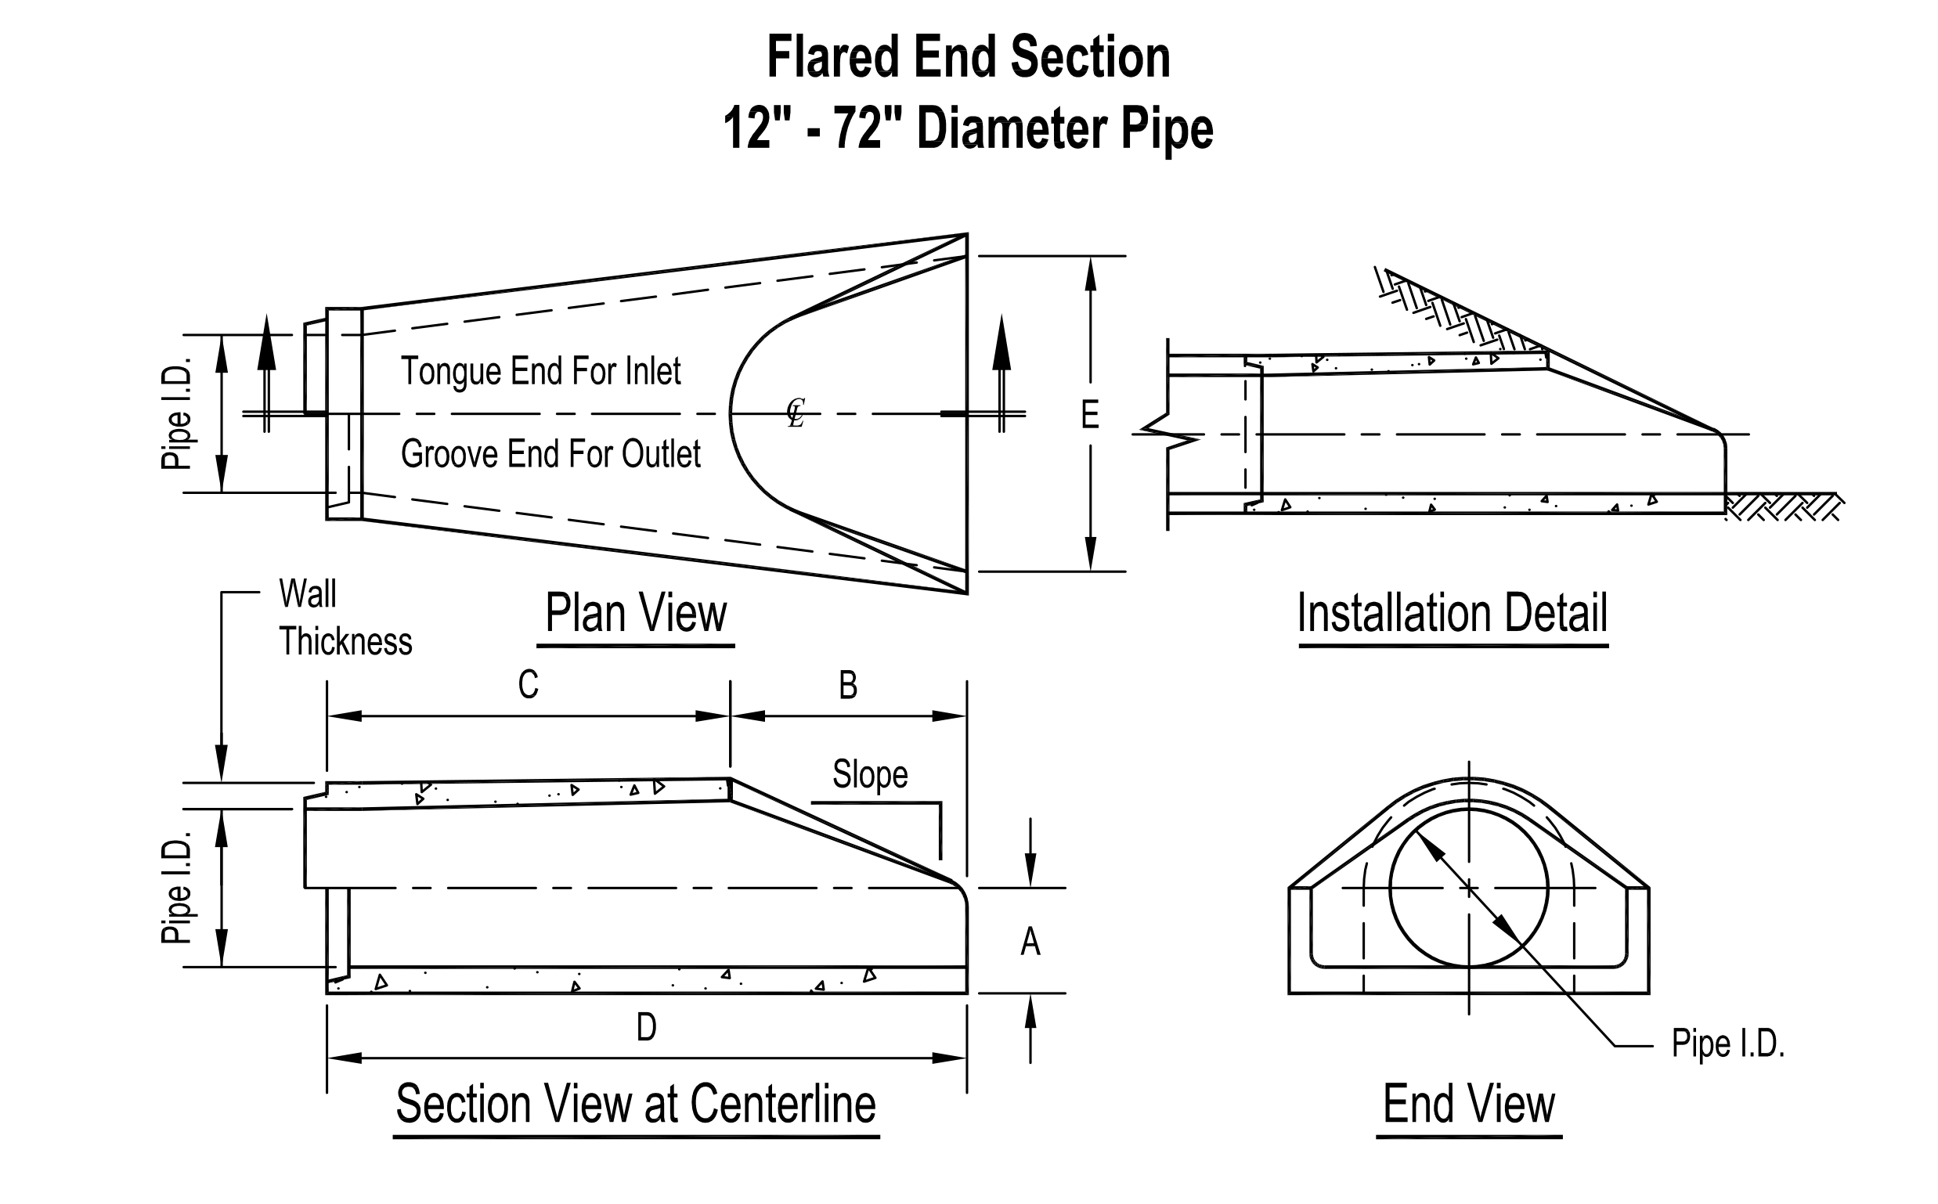

Slide 20
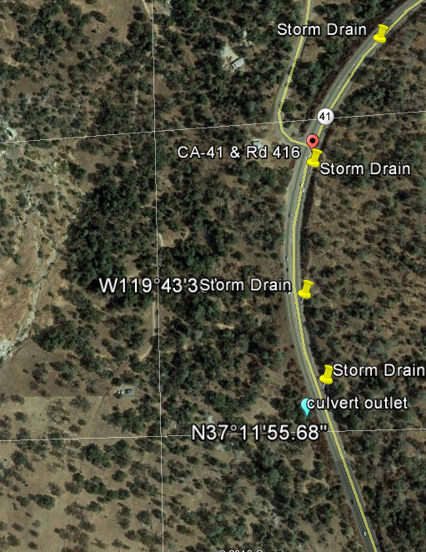
Summary Drainage System
4 curb & grate combo storm drains-type GDO
2200 ft triangular gutter- 6 in dike
1340 ft pipe -20” RCP
1 Culvert: 100 ft of 24”RCP & Flared End

Slide 21
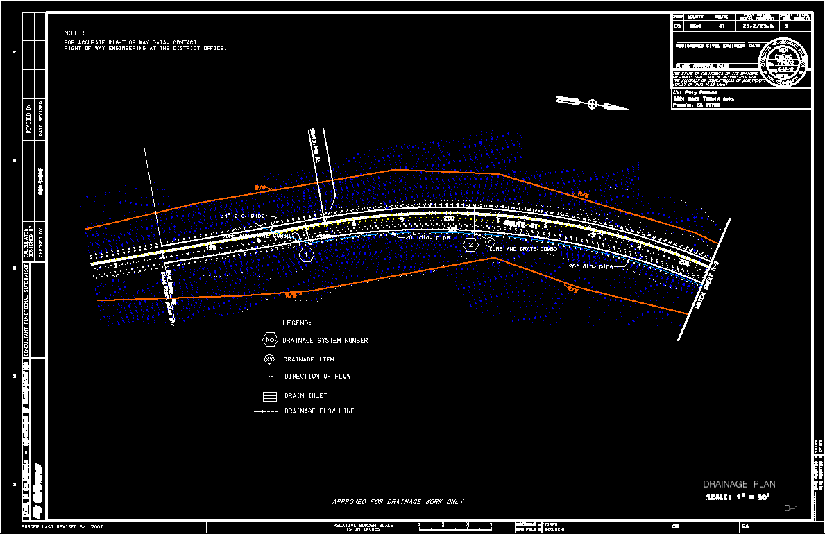
Plan and quantity sheets

Slide 22
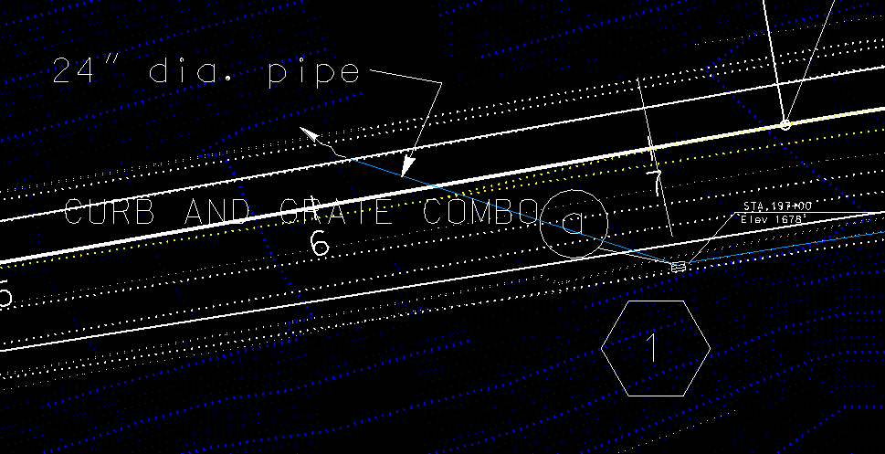
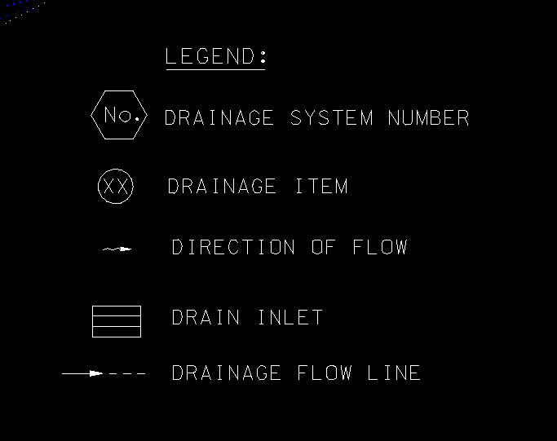
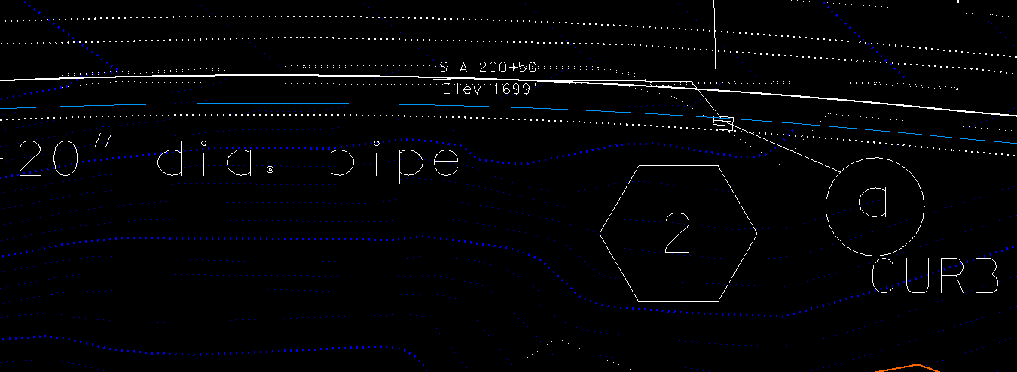
Plan and quantity sheets

Slide 23
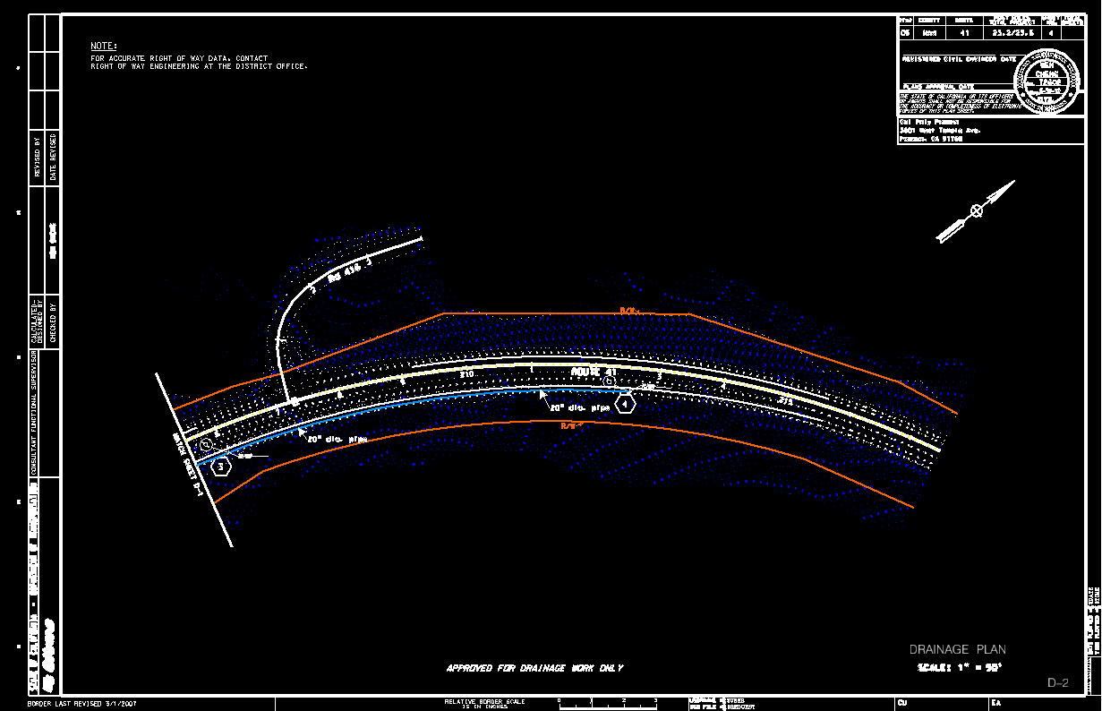
Plan and quantity sheets

Slide 24
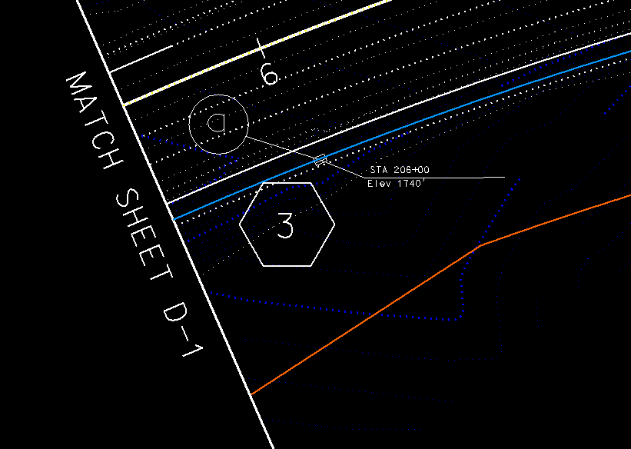
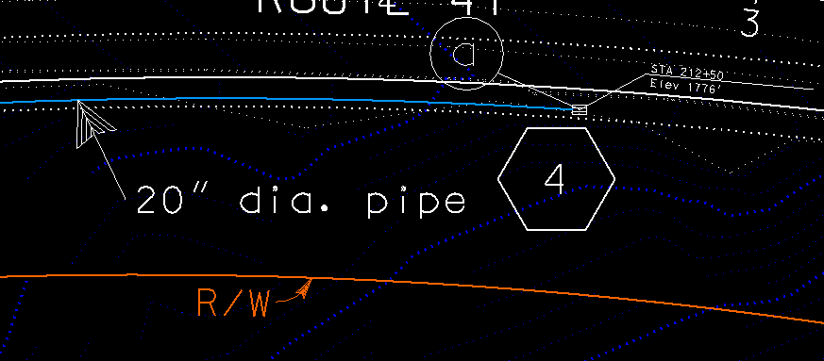

Slide 25
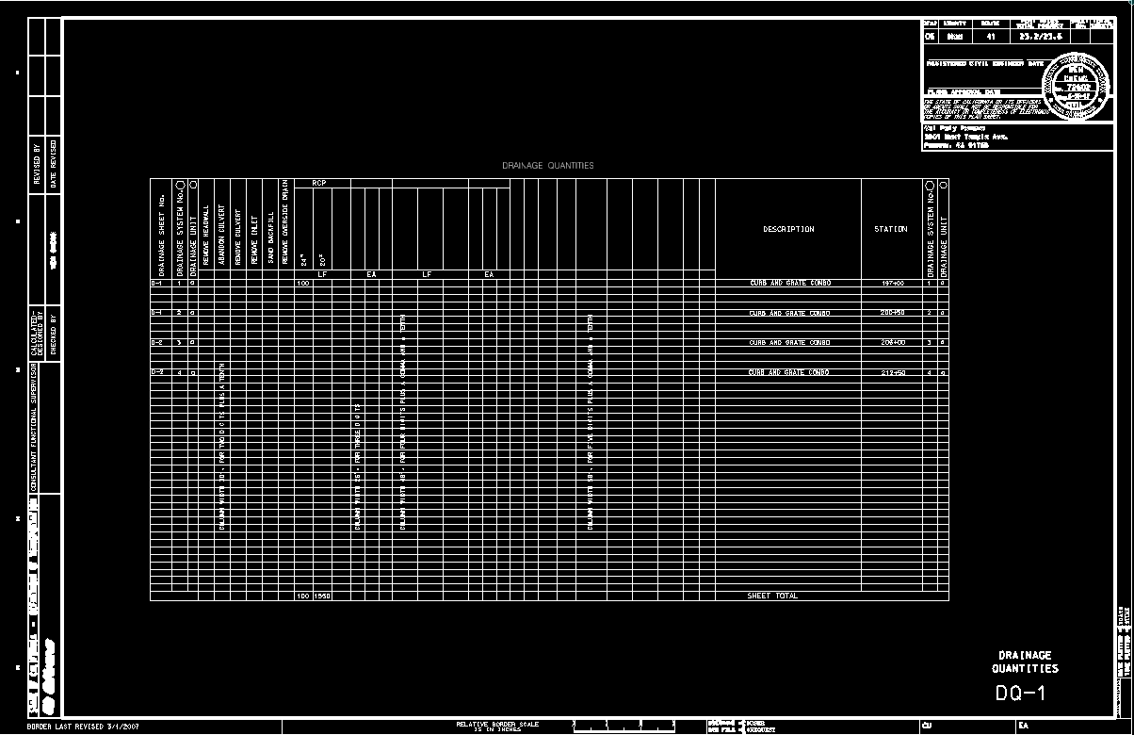
Plan and quantity sheets

Slide 26
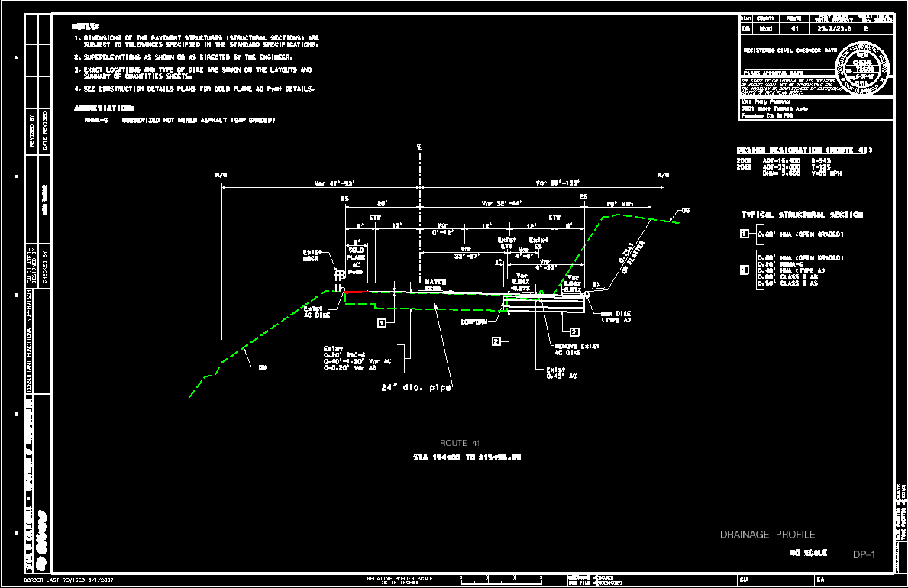
Plan and quantity sheets

Slide 27
Q & A

Slide 28
Project’s Cost Estimate
The Project Estimate of Cost serves two purposes:
• It estimates the fair and reasonable price the County should expect to pay for each of the items of work to be performed, based on expected prices as of the date the estimate is made. The preliminary estimate should be the best guide in determining whether or not the bids were valid and competitive.
• It provides the ability to review if current funding is sufficient

Slide 29
Project’s Cost Estimate

Slide 30
Project’s Cost Estimate

Slide 31
Q & A

