Slide 1
Plant Removal, Planting, Utility, and Lighting Plans
By:
Brendan Pang
Manny De Leon
Karanveer Deol
Raven Ramos

Slide 2
Plant Removal Process
Prevents overcrowding of plants and trees.
Responsibility of: Landscape Specialist and District Landscape Architect
If the front row shrubs are dominating the roadway, remove it.
Allows second row of shrubs to grow at a more natural pace and avoids inconsistent, cost frequencies.
Dead ornamental trees and shrubs within the RoW should be removed
Notes:
http://www.dot.ca.gov/hq/maint/manual/2014/21_Chpt_E_July_2014.pdf

Slide 3
Plant Removal Process
Avoid planting/leaving trees or shrubs in areas subject to snow and icing
Lets road be exposed to sun and wind
Plants destroyed in roadway related accidents should be replaced unless the adjacent plant growth shall fill in the open spaces at a convenient rate.
Sites with homeless and security issues may call for the need of plant removal.

Slide 4
Planting Guidelines
Highway planting is vegetation for aesthetic, safety, environmental mitigation, stormwater pollution prevention, or erosion control.
Factors to be considered when choosing plants:
Growth rate and longevity
Climate
Fire risk
Aesthetic/ Visibility at the expected driving speed
Cost-effectiveness
Notes:
http://www.dot.ca.gov/design/manuals/hdm/chp0900.pdf

Slide 5
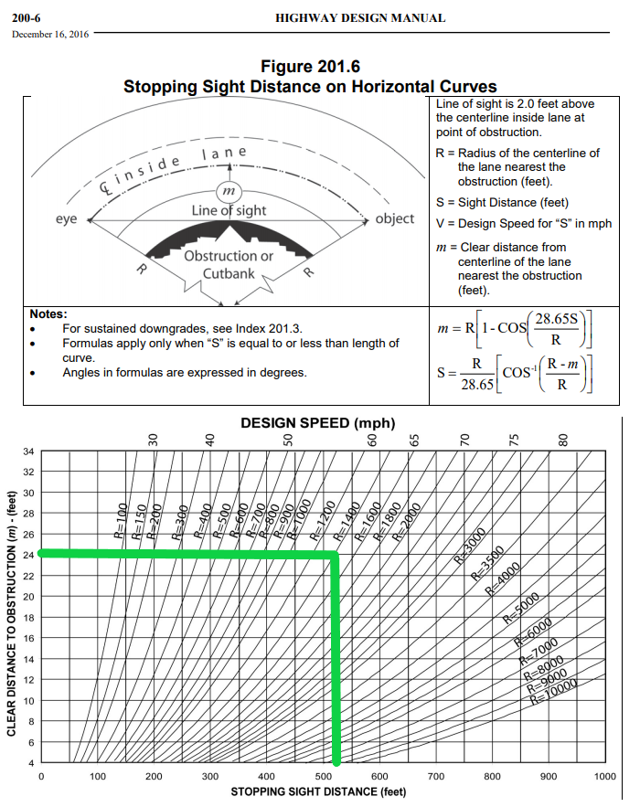
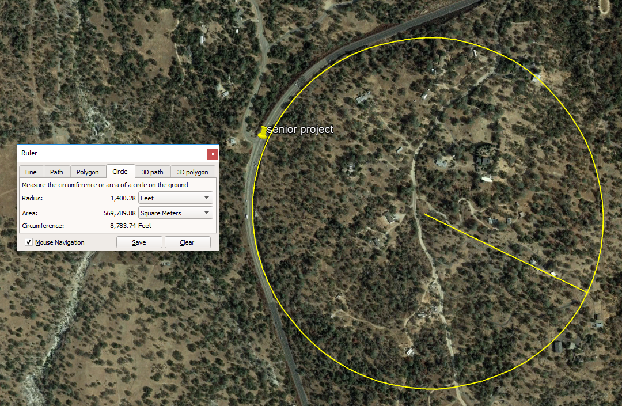
Notes:
Found in chapter 200 Geometric Design and Structure Standards, we used these formulas and graphs to get a minimum sight distance for our curve. Using google earth we approximated the radius to be about 1400 ft, resulting in a 24 ft minimum sight distance. We used a 30 ft setback from the center line to be safe.

Slide 6
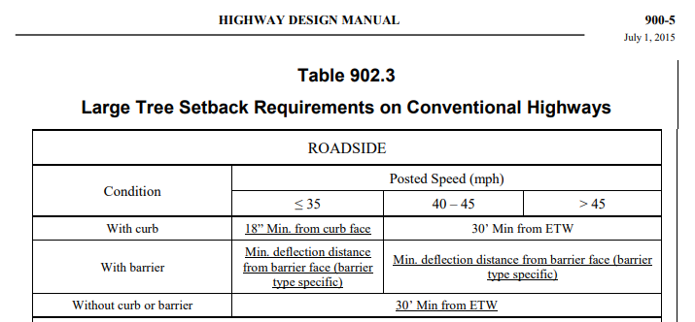
30 ft offset used as setback for vegetation above 18 inches along curves.
Dont:
Plant under utility lines
Block signing
Plant trees with brittle branches
Notes:
Found in chapter 900 Landscape Architecture, Table 902.3 says the minimum setback for trees is 30 ft from the edge of traveled way.
The “DON’Ts” are from Caltrans Landscape PS & E guide, section 4.

Slide 7
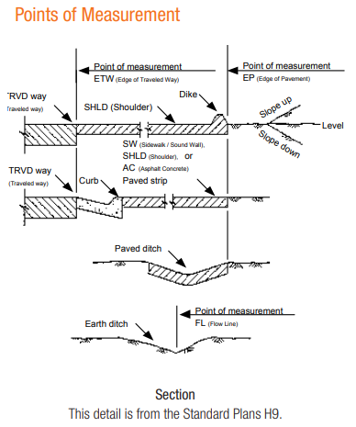
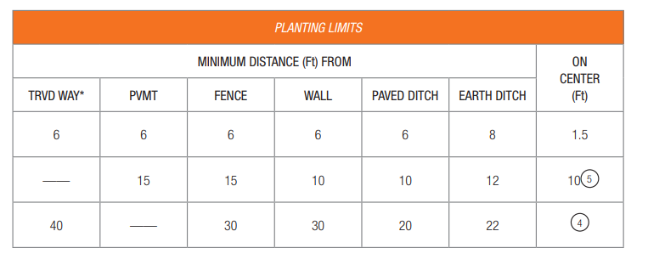

Slide 8
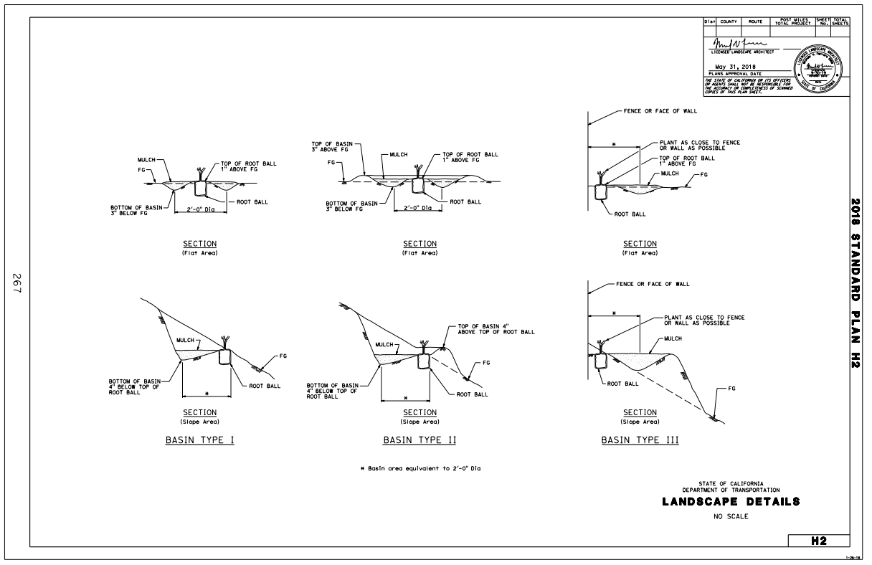

Slide 9
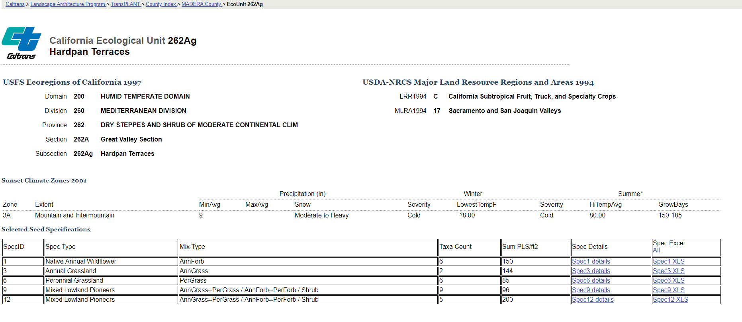
Notes:
Found on the CalTrans, Landscape Architecture Program: “TransPLANT”, we found information on plants used around specific routes. So we navigated to the District 6>Fresno>Route 41 to reach this page. Here is only a portion of the 35 different varieties of plants along route 41.
https://transplant.dot.ca.gov/PostMileTable.php?CoCo=38

Slide 10
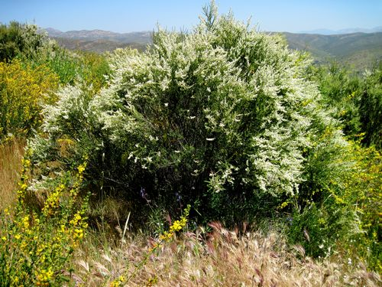
Plant Selection - Shrubs
Common Name | Chamise
Scientific Name | Adenostoma fasciculatum
Lifeform | Shrub
Duration | Perennial > 3 years
Flowering Month | June - August
Plant Height | 3-13 ft

Slide 11
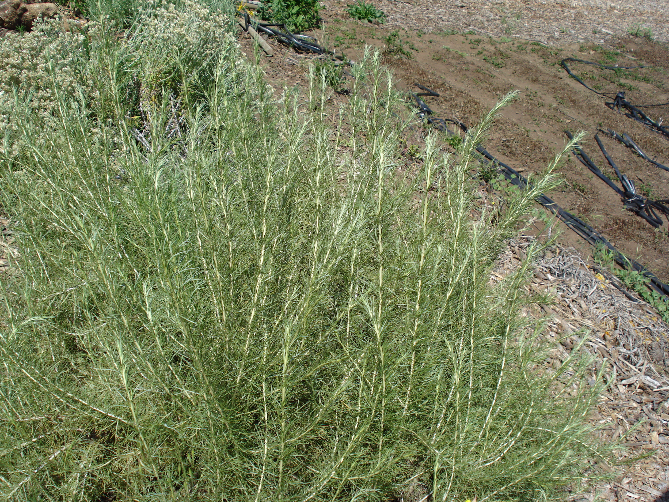
Plant Selection - Shrubs
Common Name | California Sagebrush
Scientific Name | Artemisia californica
Lifeform | Shrub
Duration | Perennial > 3 years
Flowering Month | April - October
Plant Height | 1-8 ft

Slide 12
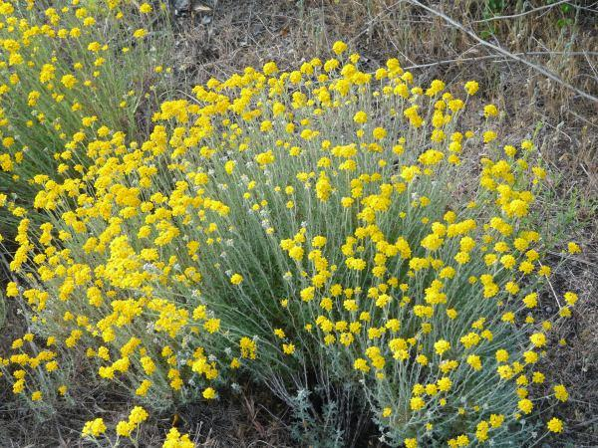
Plant Selection - Shrubs
Common Name | Golden Yarrow
Scientific Name | Eriophyllum confertiflorum
Lifeform | Sub Shrub
Duration | Perennial > 3 years
Flowering Month | February - August
Plant Height | 1.5 - 2.3 ft

Slide 13
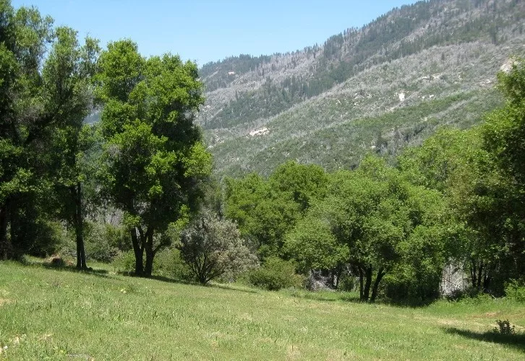
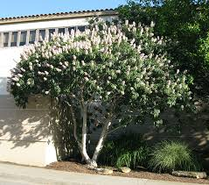
Plant Selection - Trees
Interior Live Oak
Quercus wislizeni
California Buckeye
Aesuculus califronica

Slide 14
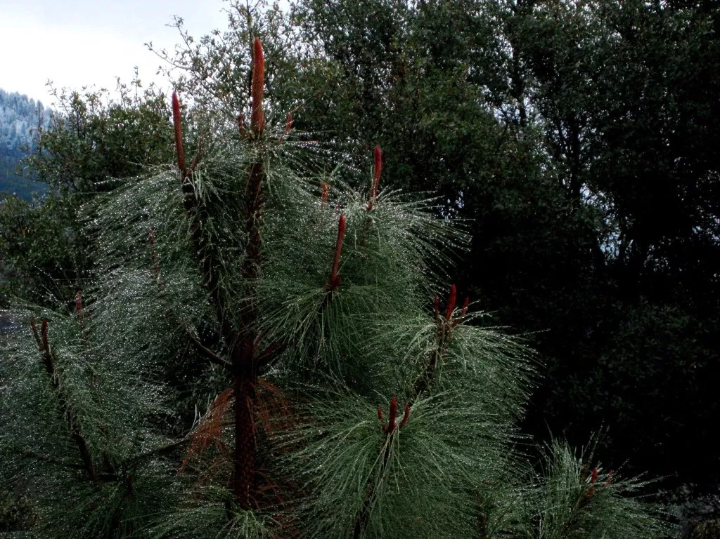
Plant Selection - Trees
Ponderosa Pine
Pinus ponderosa

Slide 15
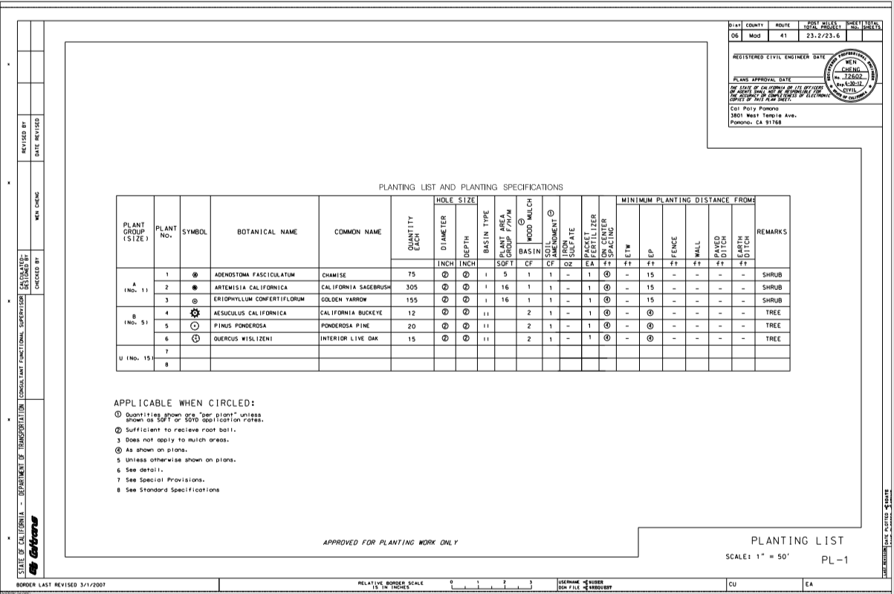

Slide 16
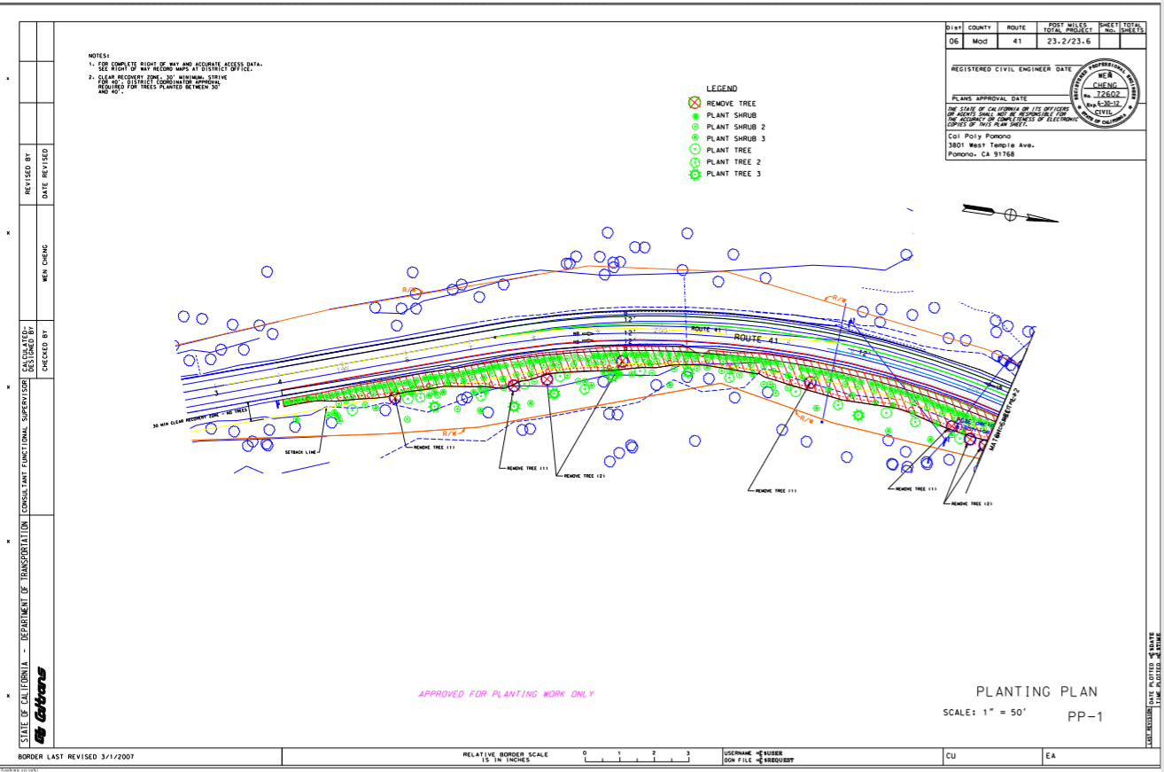

Slide 17
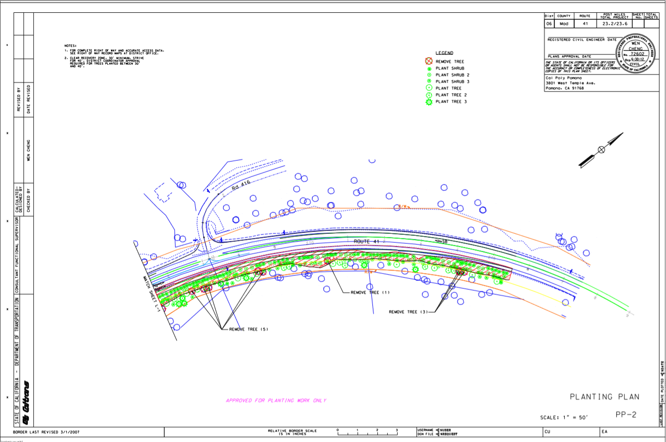

Slide 18
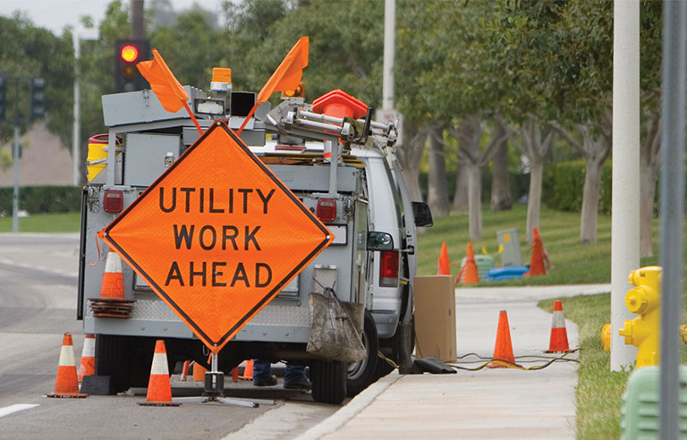
Utilities Plan
CA-41 and Route 416,
Coarsegold, CA
Madera County

Slide 19
Purpose
To show all existing and new/planned utility facilities (subsurface, aboveground, or aerial) on project plans to notify the contractor of possible utility conflicts within the project work

Slide 20
Project Site
Considering location, we assumed there would be minimal utilities
There are actually six (6) known utilities:
Electrical - Pacific Gas and Electric (PG&E)
Sewer - City of Coarsegold
Storm Drain - City of Coarsegold
Fiber Optic*
Telephone*
Television*
*No known ownership because of insufficient record drawings

Slide 21
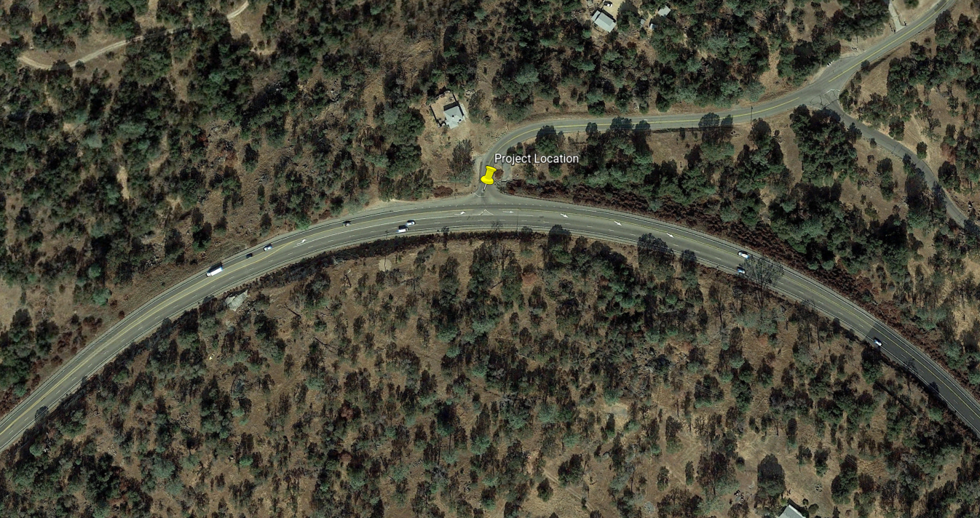
Project Site (cont.)
No plans of new utilities in project site
Project work is only done on the south side of CA-41
No utility conflicts on plan unless otherwise noted

Slide 22
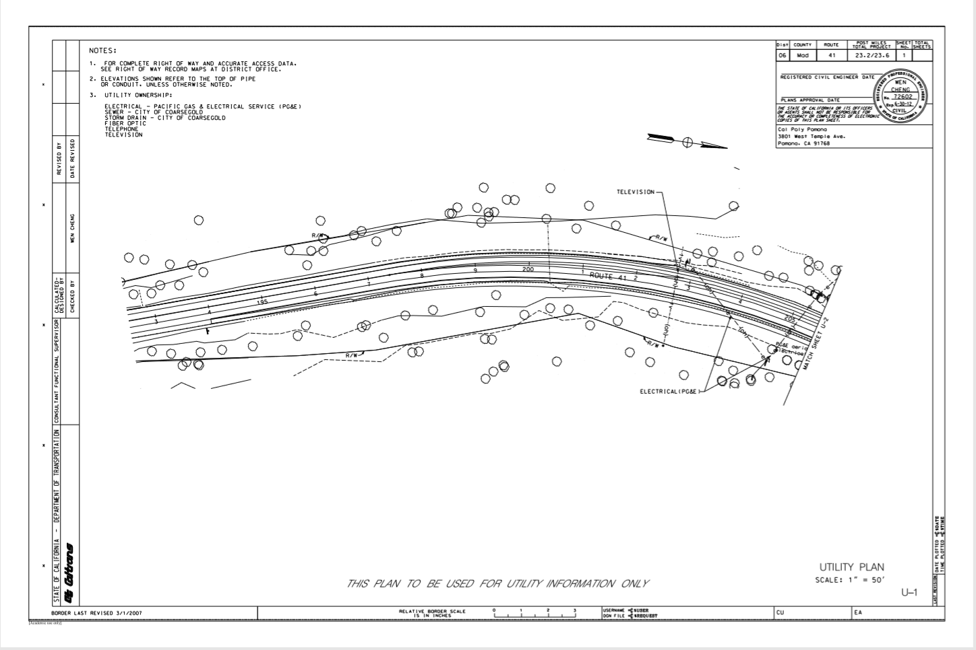

Slide 23
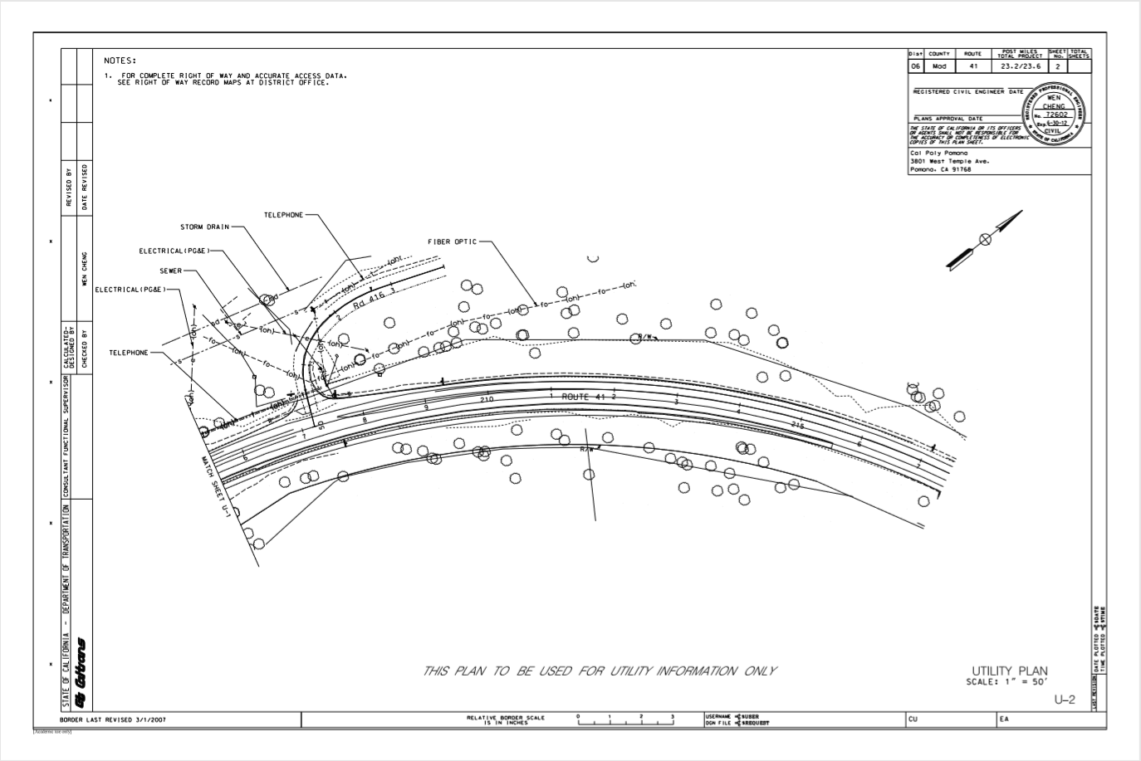

Slide 24
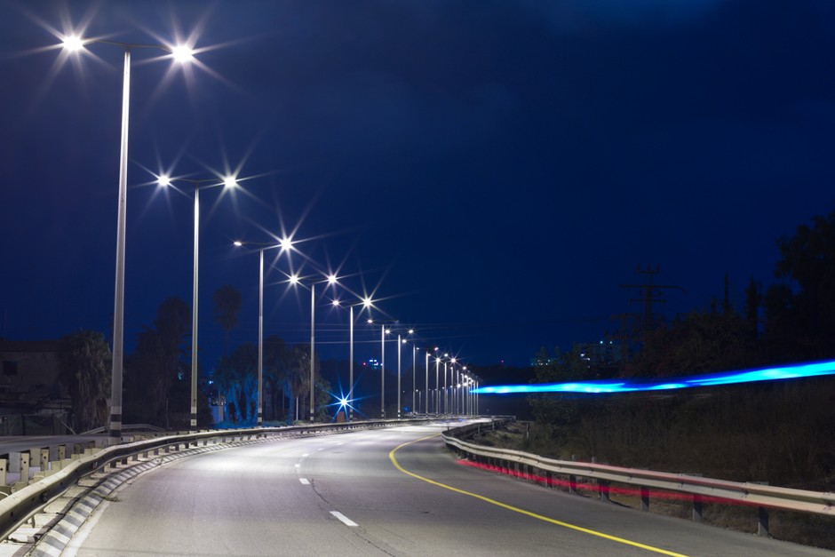
Lighting Plans
San Diego

Slide 25
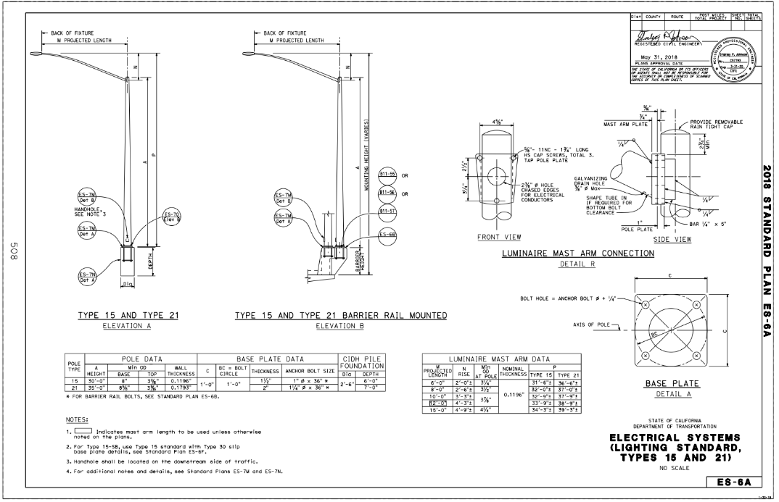

Slide 26
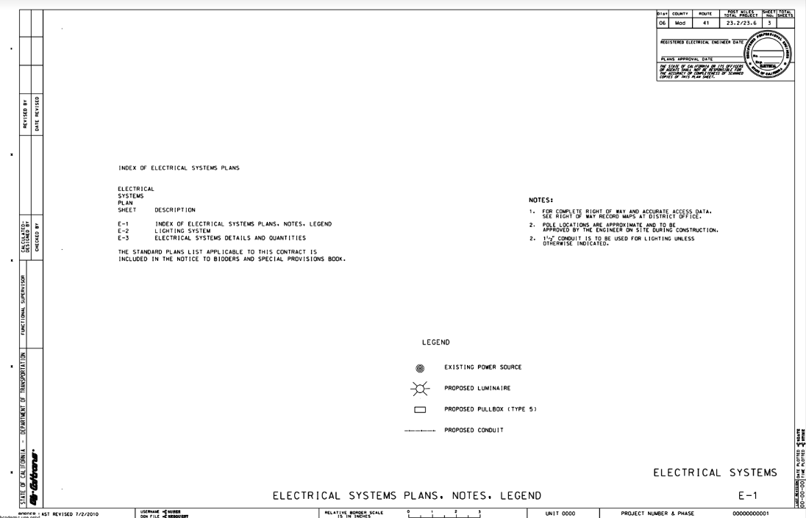

Slide 27
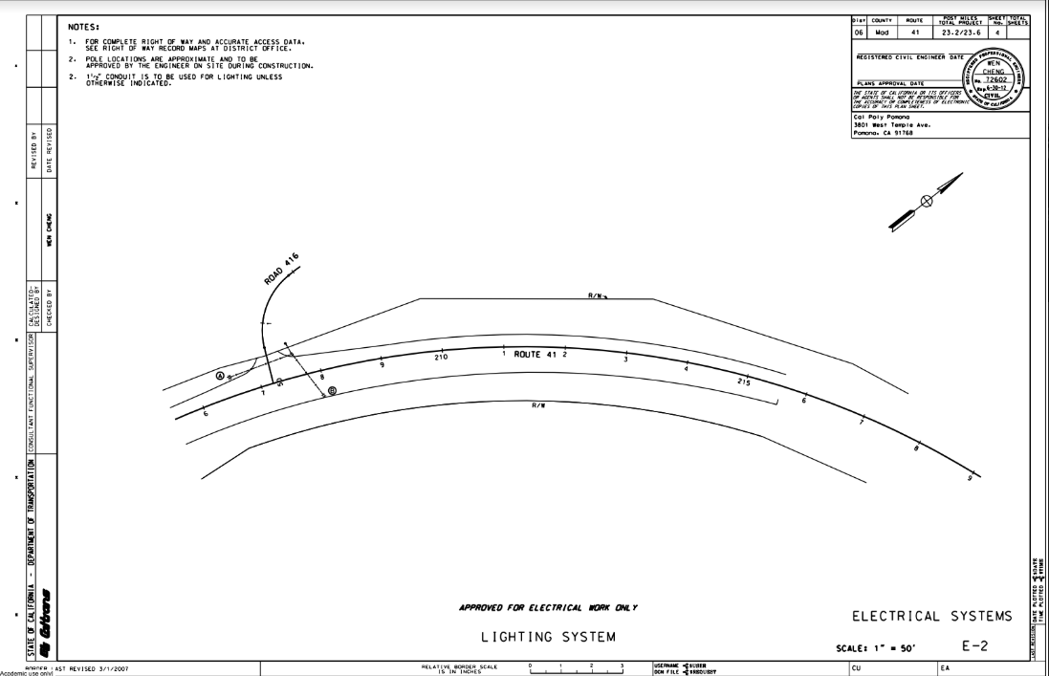

Slide 28
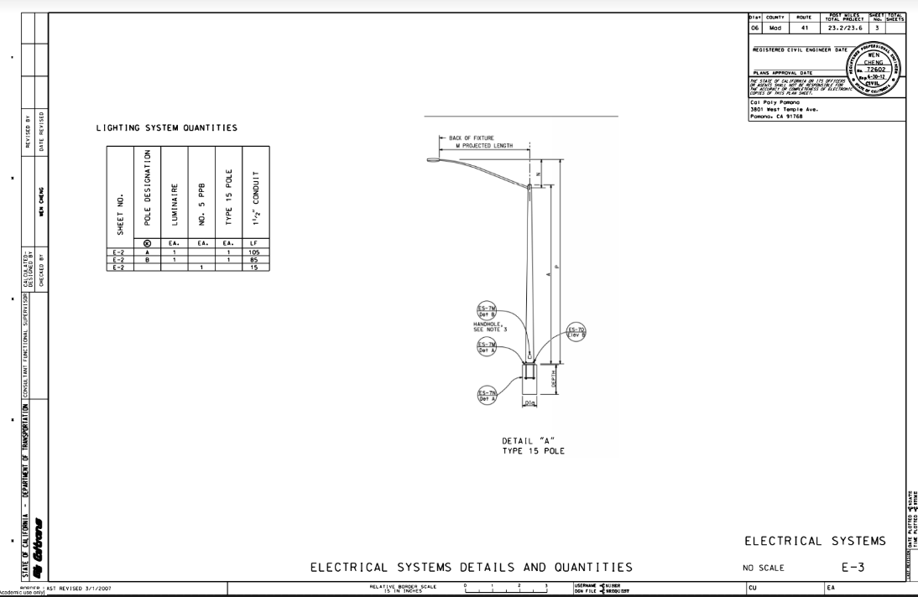

Slide 29
References
CalTrans Plans and Preparation Manual
http://www.dot.ca.gov/design/cadd/manuals/ppm.html
Highway Design Manual
http://www.dot.ca.gov/design/manuals/hdm.html
Caltrans Standard Plans
http://ppmoe.dot.ca.gov/hq/esc/oe/project_plans/HTM/stdplns-US-customary-units-new18.htm
Landscape Architecture PS & E
http://www.dot.ca.gov/hq/LandArch/16_la_design/guidance/lap_guide/index.htm
Landscape Architecture Program: TransPLANT
https://transplant.dot.ca.gov/PostMileTable.php?CoCo=38

