Slide 1
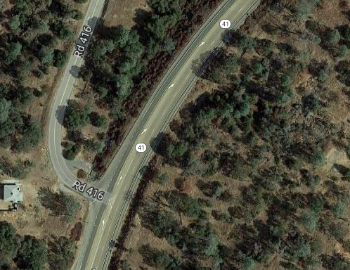
Senior Project
Erosion Control and Long Form
Prepared By:
Tien Dang
Chris Vong
Anthony Bendezu
Andres De La Cruz

Slide 2
Overview
Project Scope
Long Form
Erosion Control Plan
CADD Work
Q&A

Slide 3
Project Scope
Project limits PM 23.2 to 23.6
Sta 170+80 to 230+50 (5970 ft)
Construction limits Sta 194+00 to 215+58.89 (2159 ft)
Speed Limit: 55 mph on SR-41 & 40 mph on Rd-416
Rainfall: 10 in/year, intensity -> 1.1 in/hr
Slopes: 6% along SR-41 and 3.3% from CL to SL
Notes:
Just a quick run down of the project scope, the CA department of transpo in cooperation with Madera County transportation commission proposes to improve a 0.5 mile segment of the SR-41, project limit running from PM 23.2 to 23.6 along SR-41, which is around 0.5 mile stretch The project consists mainly of intersection enhancement at Roadway 416 and SR-41.
However for the sake of our senior project, We will be doing construction and focusing on sta 194 to 215, which is around 2000 feet long

Slide 4
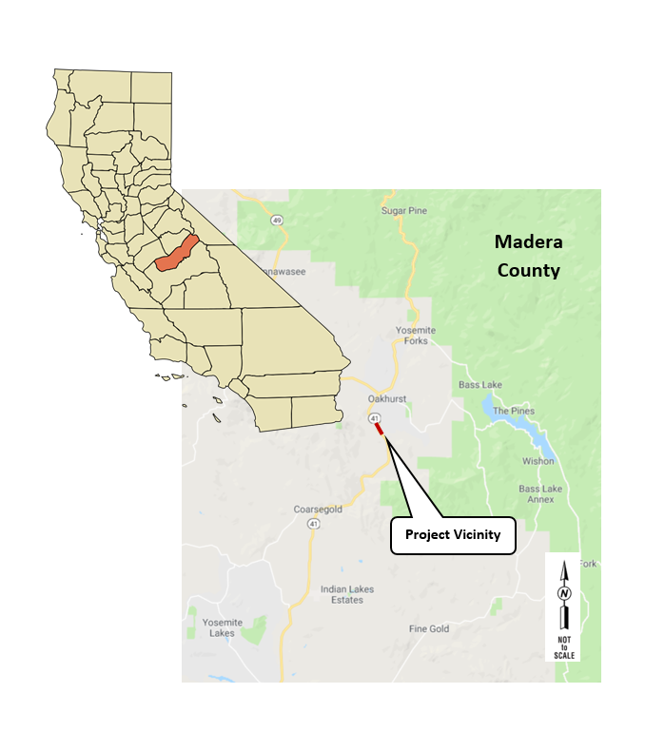
Vicinity Map
Notes:
The project is located within the jurisdiction of Caltrans District 6 and within the jurisdiction of the Central Coast Regional Water Quality Control Board - Region 5 (RWQCB)
The project limits are shown on the attached vicinity map. It it at the far northern part of the SR-41 Corridor

Slide 5
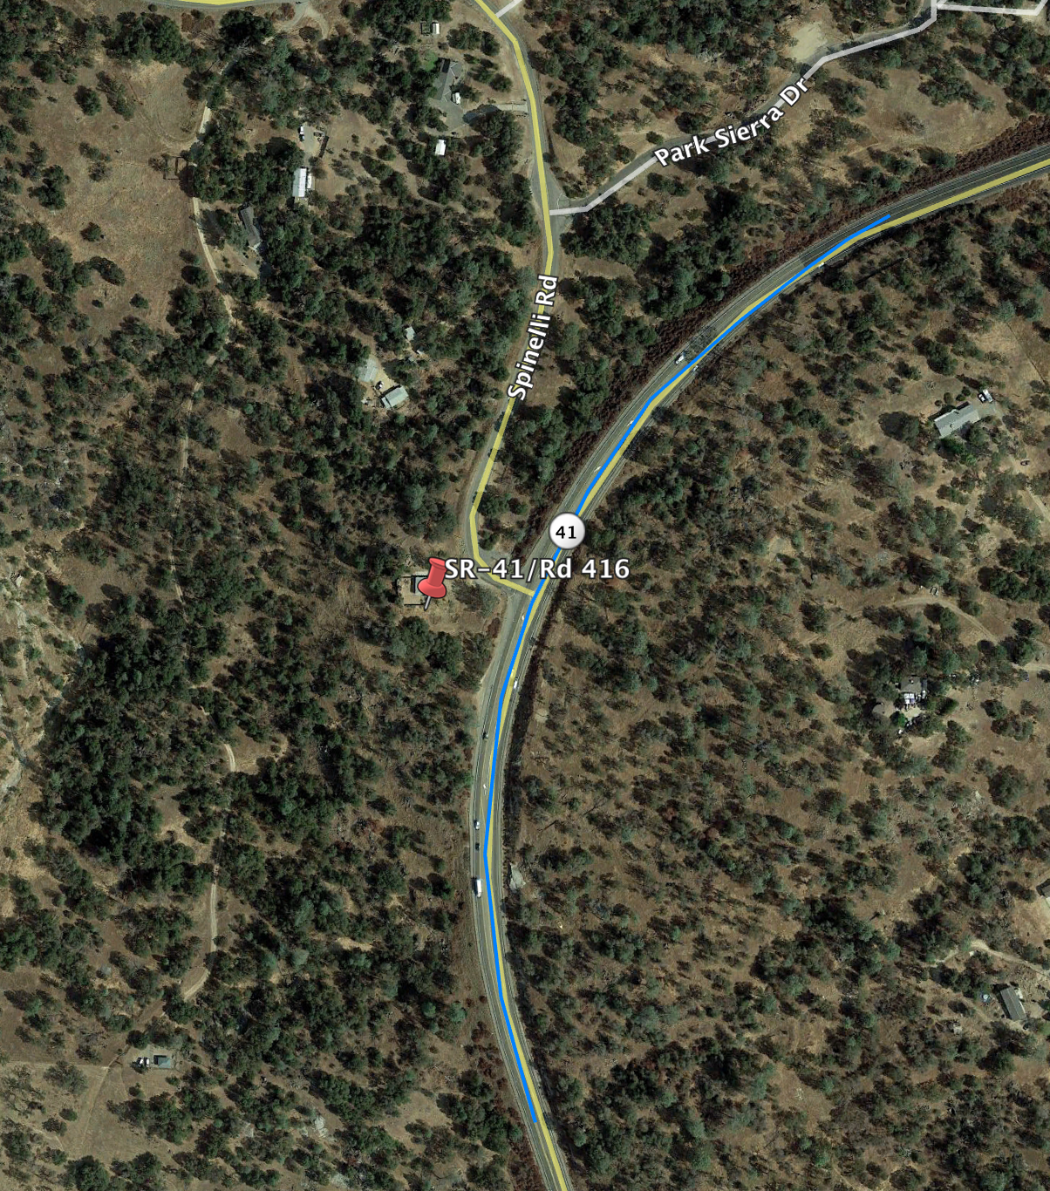
Site Data - Disturbed Soil Area
Planned area of soil disturbance
Clearing of the land for access & preparation of site for construction
Grading of the project site
Material and equipment staging area, maintenance area, and construction easement
Disturbed Soil Area of project: 8.3 Acres
DSA
DSA
DSA
DSA Potential locations
Notes:
The area was estimated using limited data and includes areas for construction, access, and staging. The DSA will be recalculated when the project survey is complete.

Slide 6
Site Data - Water Quality
The project is within the Ahwahnee Hydrologic Unit, Fresno River Hydrologic Area, and Coarse Gold Creek Hydrologic Sub-Area.
The project receiving waterbody is the Fresno River
listed for low dissolved oxygen
Source:Water Programs Water Quality Planning Tool (WQPT)
Water Quality Map
Notes:
We were able to gather information from the Water programs water quality planning tool (WQPT)
According to the map on the left hand side,
Evidently, the project receiving waterbody is the Fresno River

Slide 7
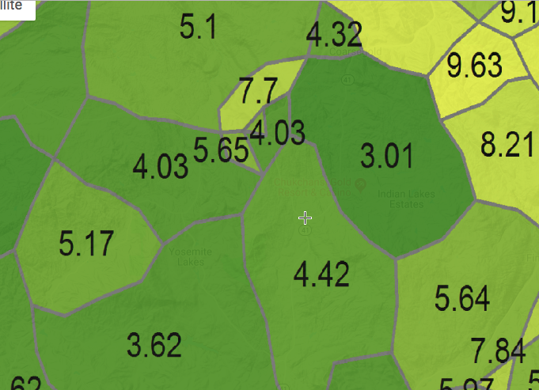
Stormwater Data Report - Sediment Risk
Source:Water Programs Water Quality Planning Tool (WQPT)
R Factor = 20
Erosivity - potential for soil to wash off disturbed de-vegetated earth during storms
LS factor = 4.42
Combines the effects of hillslope-length factor (L) and gradient factor (S)
LS Factor
Notes:
R factor - soil loss is directly proportional to rain fall factor, the factor is average annual sum of storm events during period of at least 22 years.

Slide 8
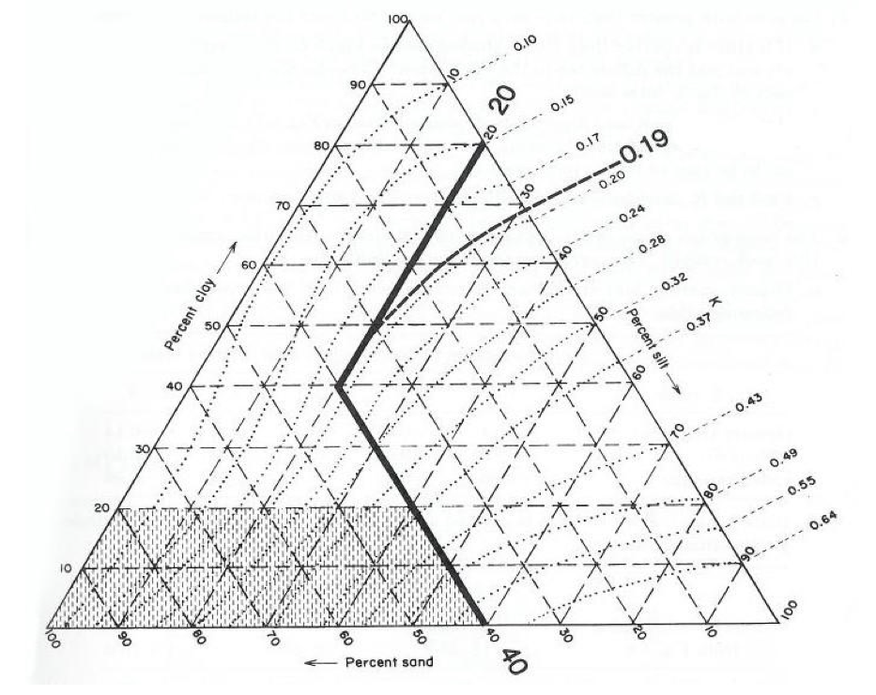
Stormwater Data Report - Sediment Risk
Source:Water Programs Water Quality Planning Tool (WQPT)
K factor = 0.2 (coarse-textured soil)
Soil erodibility - the susceptibility of soil or surface material erosion, transportability of sediment, and amount and rate of runoff given particular rainfall input
Erickson Triangular Nomograph
Notes:
Coarse textured - such as sandy soil, have high infiltration resulting in low runoff, although the particles are easily detached
Requires particle size analysis

Slide 9
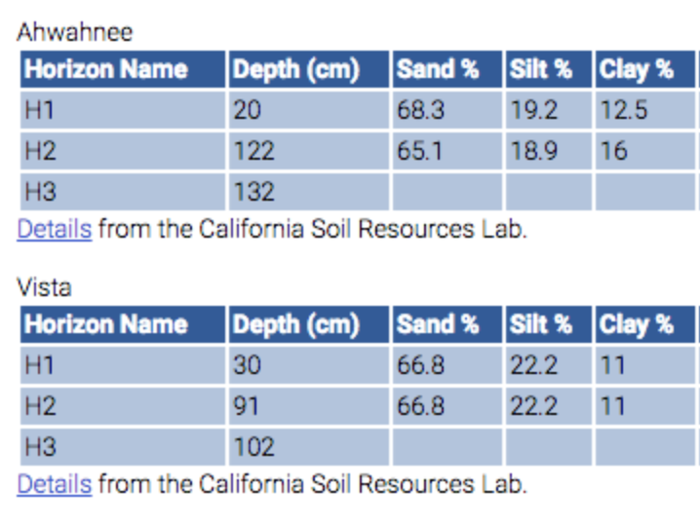
Site Data - Geotechnical
Source:Water Programs Water Quality Planning Tool (WQPT)
Soil Hydrologic Group B (loam or silty loam)
Holland Rocky Sandy Foam (35-45% slope)
Mod infiltration rate -> mod runoff potential
Moderately fine to coarse textures
Notes:
The existing soil type within the project limits is Soil Hydrologic Group B (silty loam or loam)per the WQPT. The predominant soil type in the project area is the Holland Rocky Sandy Foam (35-45% slope). HSG B is defined as soils having moderate infiltration rate (moderate runoff potential) when thoroughly wetted and consists of chiefly or moderately deep to deep, moderately well to well drained oils with moderately fine to moderately coarse textures.

Slide 10
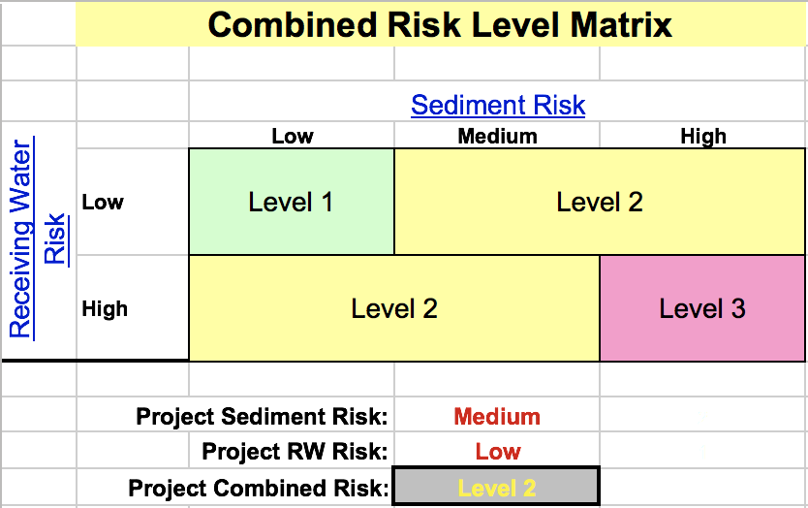
Stormwater Data Report
Source: State Water Resources Control Board Worksheet

Slide 11
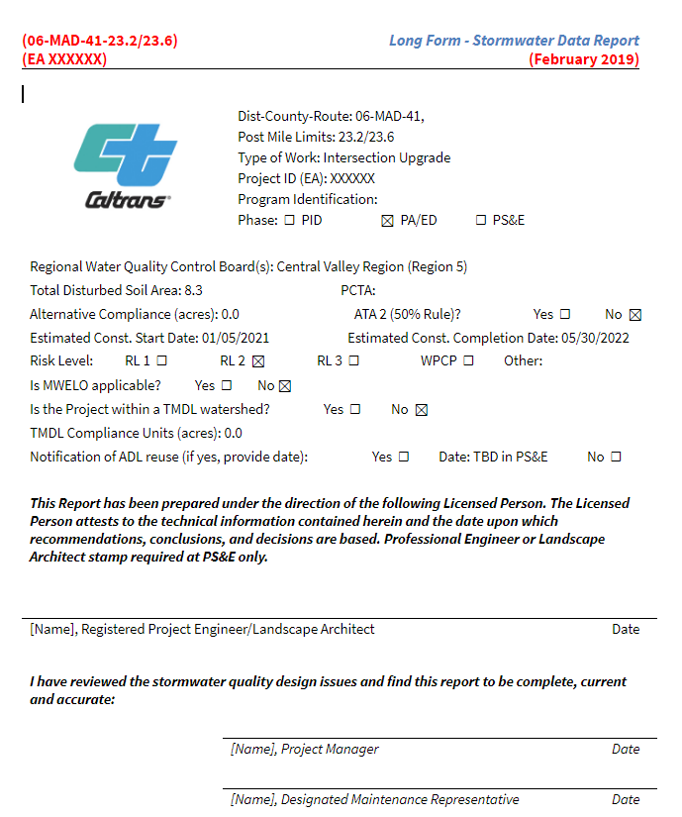
Long Form

Slide 12
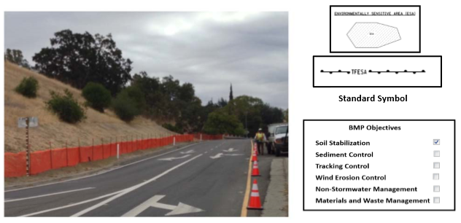
Erosion Control (Type and Materials)
1. Preservation of Existing Vegetation
Identification and protection of desirable vegetation to provide erosion and sediment control.
Why?
Use resources already in place to stabilize soil; it is cheaper.
Application:
Silt fence will be placed along the edge of right of way of construction zone. Vegetation will be preserved in areas that will not be under immediate construction.
Materials:
In addition to the selected vegetation, orange silt fence,wood posts (4ft), and staples (diam. of 1/16 in).
Notes:
Design Pollution Prevention (DPP) BMP Strategy
This project will involve clearing, grubbing, and excavation in specific locations that will be defined
on the plans to maximize the preservation of existing vegetation. Areas that are off limits to the
contractor will also be delineated on the plans. These locations will be more defined in the design
phase.

Slide 13
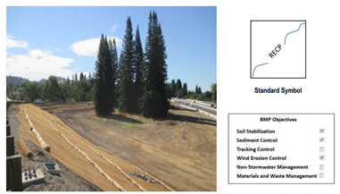
Erosion Control (Type and Materials)
2. Temporary Cover and Rolled Erosion Control Products (RECPs)
Stabilization of disturbed soil areas and protection from erosion caused by wind or water
Why?
Protect exposed soil due to construction and to redirect the flow of water as needed.
Application:
Applied only to disturbed soil areas undergoing construction.
Materials:
Jute mesh and fiber rolls.
Triangular wooden stakes for anchoring.

Slide 14
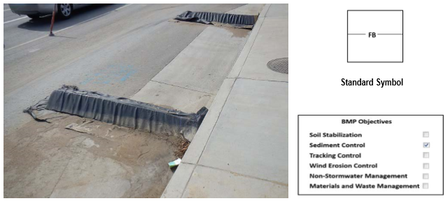
Erosion Control (Type and Materials)
3. Flexible Sediment Barrier
Sediment control and stormwater control and collection.
Why?
Reduce the energy stormwater flow and capture sediment before reaching storm drains.
Application:
Placement along the shoulder line of the construction length of the project in 50 ft increments.
Materials:
Flexible barriers (geosynthetic fabric with a urethane foam-filled).

Slide 15
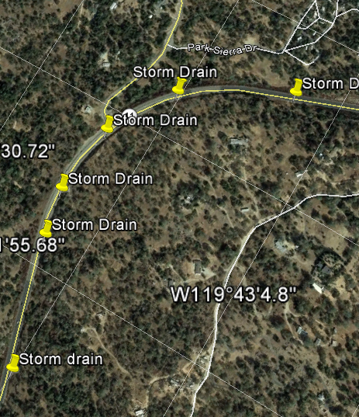
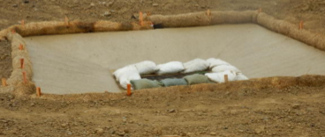
Water diversion
Stormwater runoff from project site should be directed to the closest storm drain, where the inlet should be protected as an additional BMP to avoid sediment entering the water course.

Slide 16
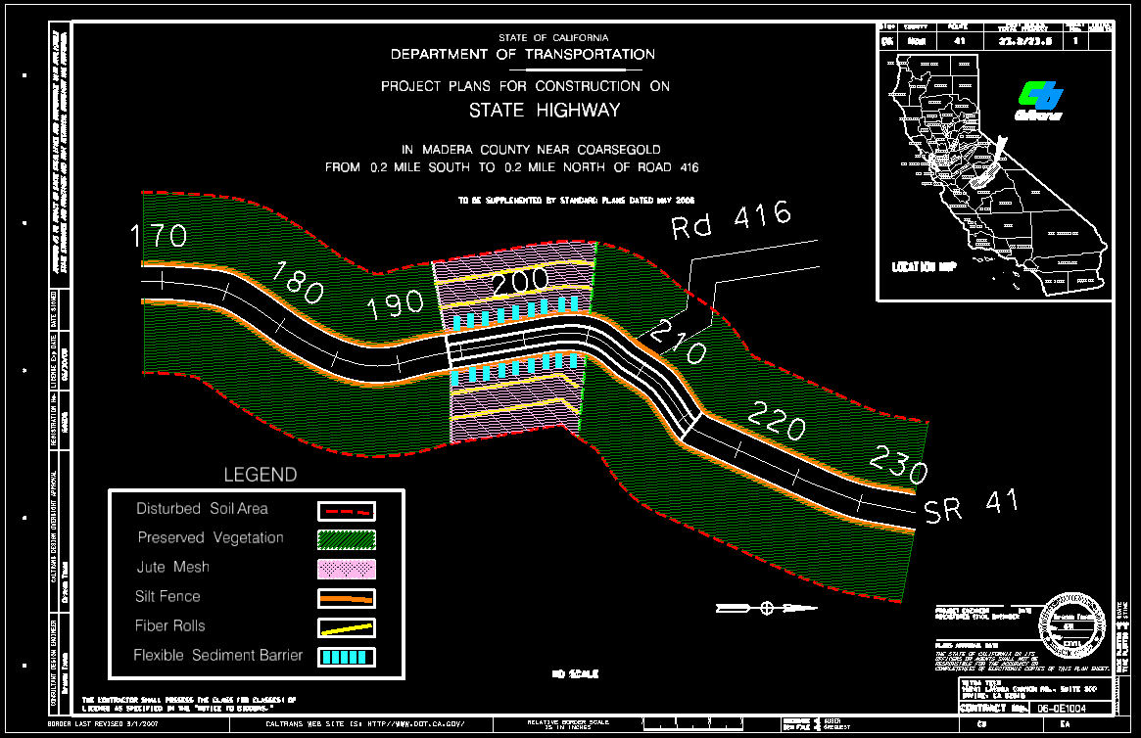
CADD Work

Slide 17
Thank You
Questions

Slide 18
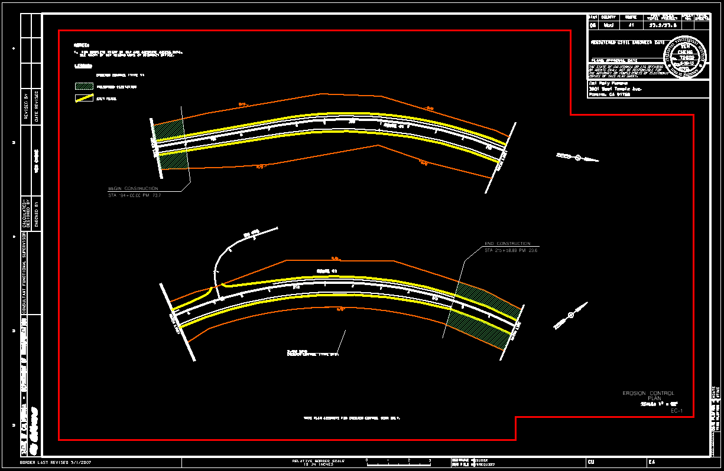

Slide 19
