Slide 1
Construction Area Signs Used on SR 41 and Road 416
By: Raven Ramos
Brendan Pang
Karanveer Deol
Manny De Leon

Slide 2
Table of Contents
Purpose
Signs Selected
Layout

Slide 3
Purpose
“Construction area signs, shown on the construction area sign plans, are only those signs that identify the begin and end points of project work on the state highway involved and the signs placed on local streets which intersect or connect to the state highway within the project limits” (Plans Preparation Manual 2-2.14)
Notes:
Roads include streets, highways, bikeways, and private roads.

Slide 4
Signs Selected
Based on site review and the CA-MUTCD….
Sign | Description
W20-1 | Road Work Ahead
G20-2 | Road Work Ends
C40A(CA) | Fines Doubled
C47B(CA) | Project Description
Notes:
Add to traffic control module:
C23B(CA) Highway Widening
W3-5(XX), W13-1P (XX) Speed Limit Ahead, Speed Limit Construction Zone
W21-5 Shoulder Work
Traffic Cones -

Slide 5
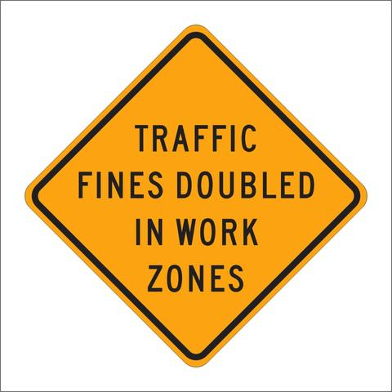
Project Description
Fines Doubled

Slide 6
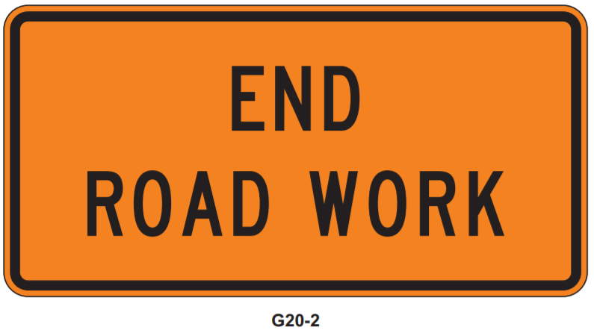
Road Work Begins
Road Work Ends

Slide 7
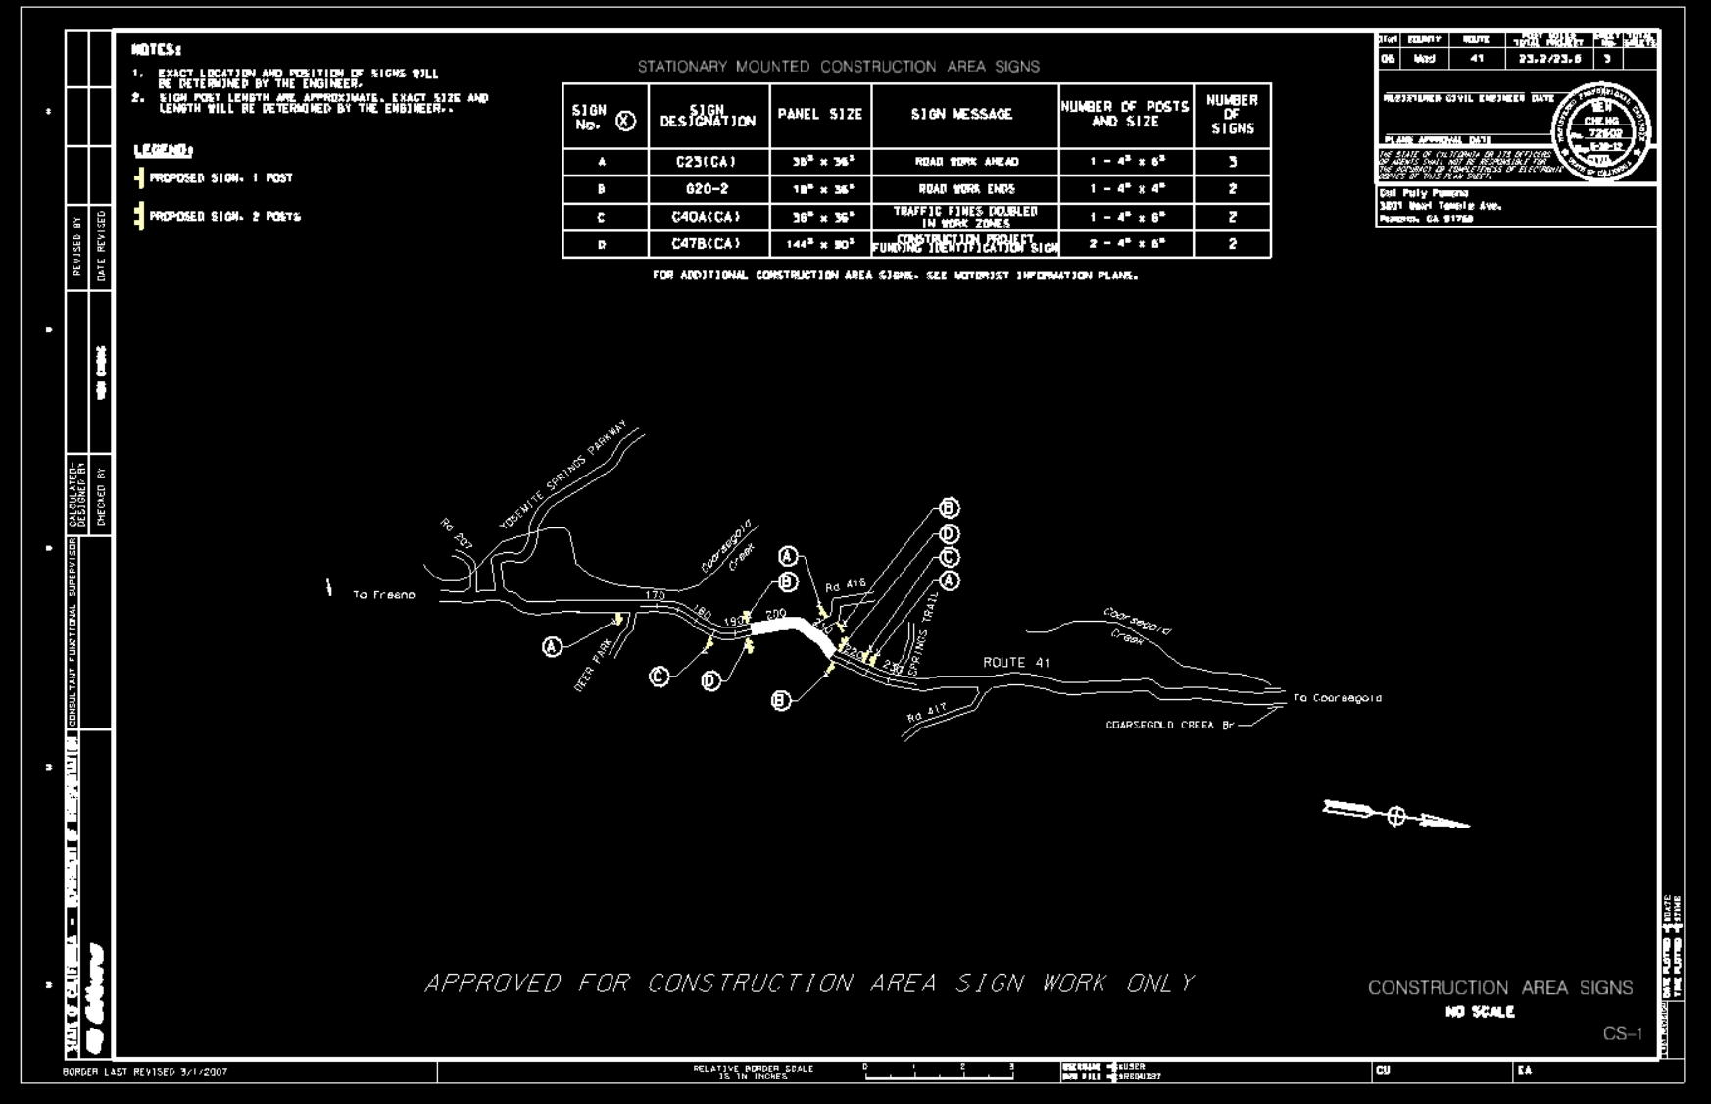
Notes:
NEED TO EDIT THE NUMBERS, MAKE SURE BOTH DIRECTIONS AND THE … every road should have 3 of everything

Slide 8
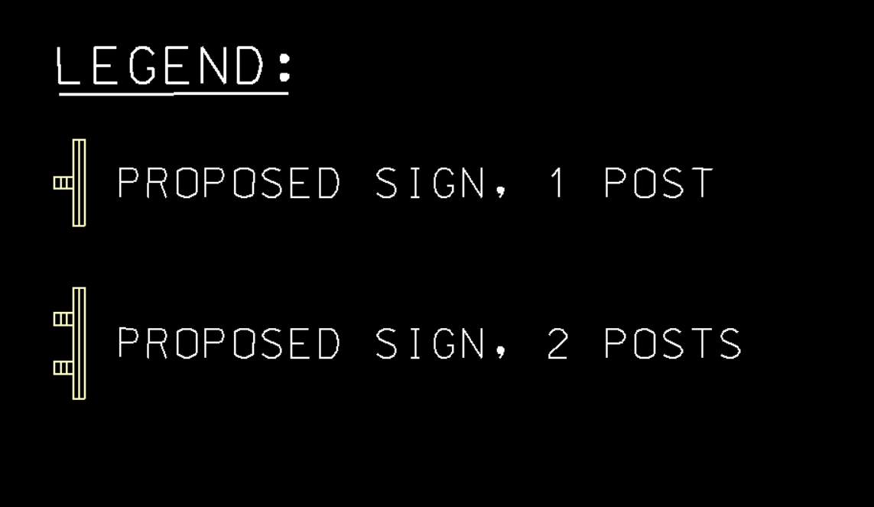

Slide 9
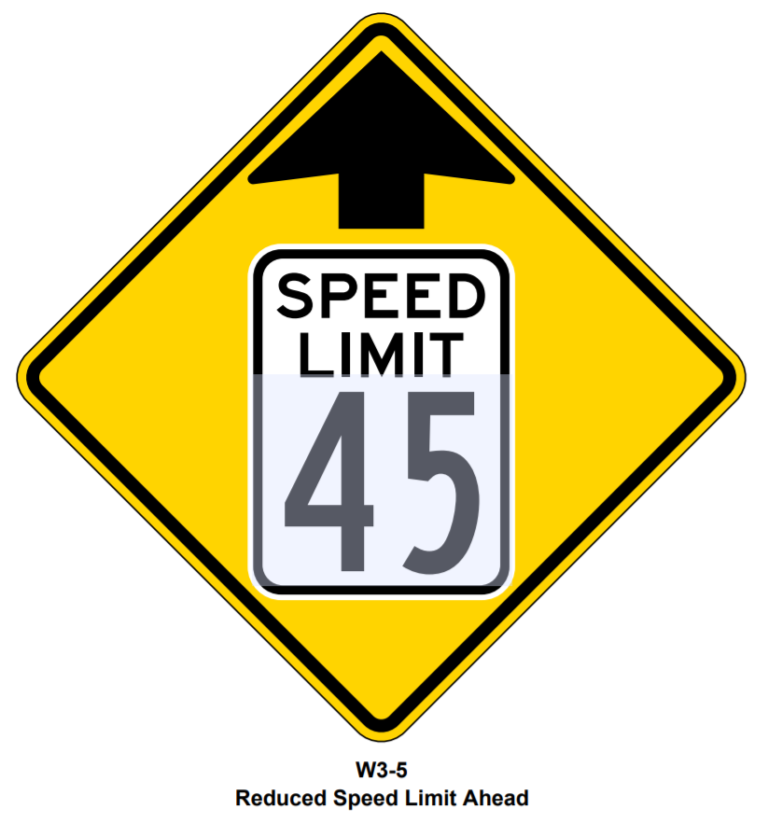
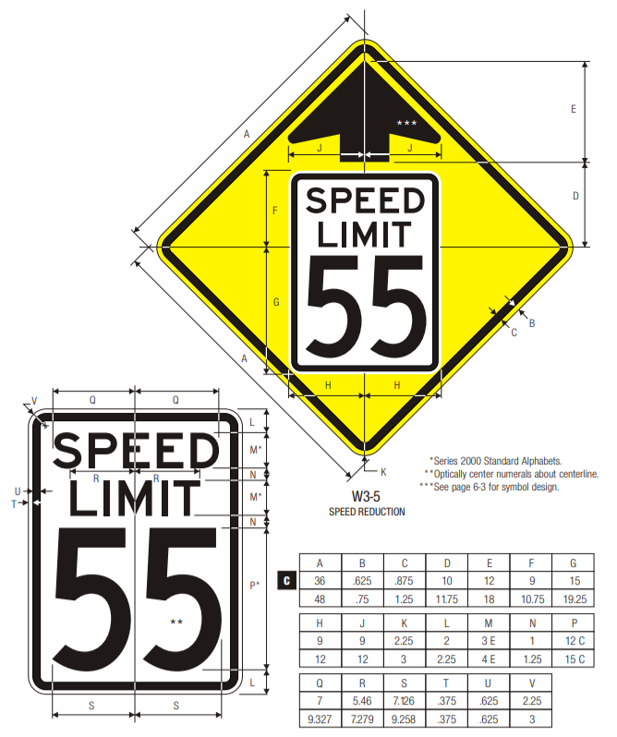

Slide 10
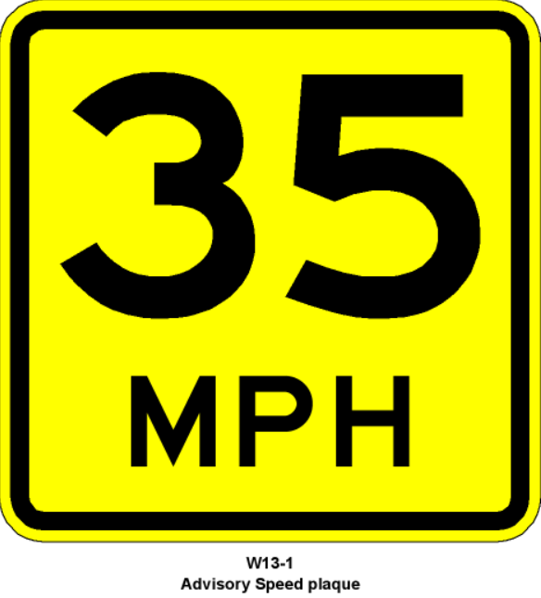
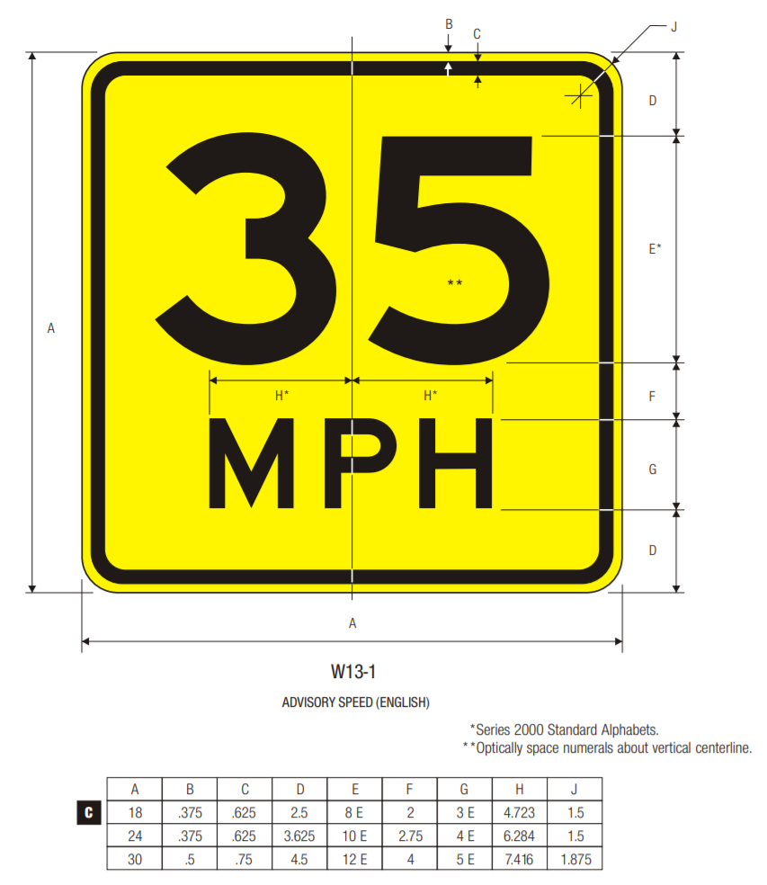

Slide 11
http://www.dot.ca.gov/trafficops/camutcd/camutcd2014rev2.html
Sections to read:

Slide 12
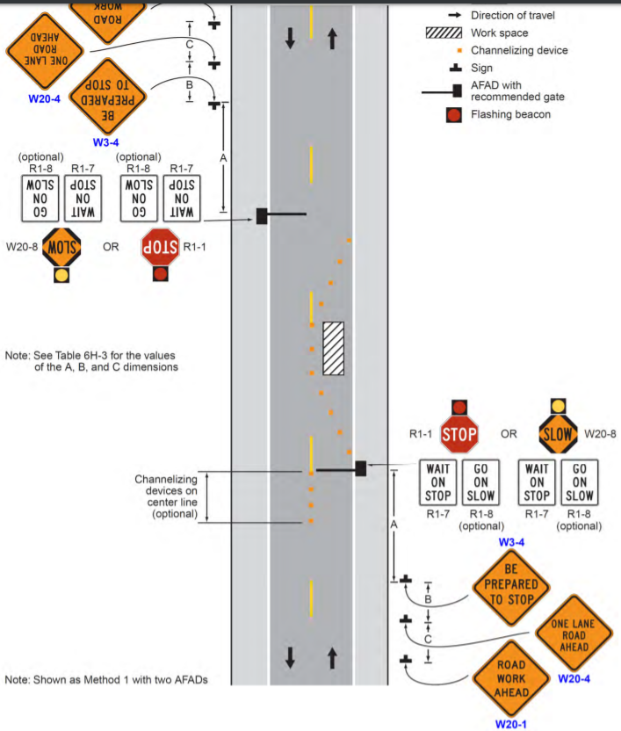
**ASK OTHER GROUP IN MORNING
If we need to make it a 1 lane road for construction we will need to indicate:
Road work ahead
Flagger
Wait on STOP, go on SLOW
Be prepared to stop
One lane road ahead
Speed limit
End work zone speed limit
CMS (changeable message sign) (probably put this on here anyways)
Lane closed
Or if we are just doing shoulder lane construction:
Road work ahead
Shoulder work ahead (no flagger needed)
Speed limit
End work zone speed limit
CMS

Slide 13
Additional signs we may need- brendan
Loose gravel
Fresh concrete
barricades/ traffic cones
workers
Different signs based on what stage in the construction process we are in
Can have 1 plan for each stage [but this is extra work]
Each stage meaning, if we went the route of segmenting the project into parts of the highway we are working on at the time.
This minimizes the amount of temporary erosion control BMPs needed
Center lane closed ahead? - for repainting the lines/ turn arrows on the road
Right lane closed ½ mile

Slide 14
Sources
California Manual on Uniform Traffic Control Devices (CA-MUTCD) (2014, Revision 3)
CalTrans Highway Design Manual
CalTrans Plan Preparation Manual 2-2.14 to 2-2.16
California Manual on Uniform Traffic Control Devices (CA MUTCD)
http://www.dot.ca.gov/trafficops/camutcd/camutcd2014rev2.html
Chapter 6f.07
6f.17
http://www.trafficsign.us/
http://www.dot.ca.gov/trafficops/tcd/specs.html

